Slide 1
STUDY OF IMPLEMENTATION OF THE NEW AUTONOMOUS REGION IN DEVELOPMENT ASPECTS (CASE STUDY "X" DISTRICT IN WEST JAVA)
Sutia Budi
Arya Hadi Dharmawan, Akhmad Fauzi

Slide 2
Introduction
District "X" is one of the districts in West Java province, Total District residents "X" = 1.510.284 people (BPS, 2010)
Coverage of the district of "X", covering 15 (fifteen) sub districts, District "X" formed through a long process.
District Parent discourse division into two (2) districts have emerged since l999.
The demands of regional divisions views of geography that quite spacious (2.324.84 KM2) by total population of 4.3 million people (2002),
Law Number 32 Year 2004 on Regional Government
Law Number 33 of 2004 on Financial Balance-Regional Center

Slide 3
Introduction
The Based Dimensions of Decentralization and Regional Autonomy, the dimensions of economic and political dimensions.
the dimensions of economy
the momentum of the rise of economic democracy, the region's autonomy, the ultimate goal of public welfare.
political dimensions
improve skills and political ability of the organizers of governmentan and community and to maintain national integration.

Slide 4
Introduction
Basic principles of regional autonomy,
1) Broad autonomy principle ;
2) Real autonomy principle ;
3) Responsible autonomy principle.
The Implementation of regional autonomy should capable improve development performance, improving the quality of public services, and promoting community empowerment characterized by increased participation and strengthening community spirit of collectivity.
The objectives of this study was to assess the implementation of regional autonomy in terms of aspects of development in the district of "X" in West Java.

Slide 5
literature Review
Philosophically, the development process can be defined as the systematic and continuous effort to create a state that could provide a legitimate alternative for achieving the aspirations of every citizen of the most humanistic. In other words, the development process is a process of humanizing
New development paradigm directed towards the equity, growth and sustainability in economic development.
(Rustiadi, 2008).
Development must be viewed as a multidimensional process that covers a wide range of fundamental changes on the structure sosial, community attitudes, and national institutions, in addition to still pursue the acceleration of economic growth, the handling of income inequality, and poverty alleviation.
(Todaro, 2003)

Slide 6
Method
The method used is descriptive method with a combination of quantitative and qualitative.
Descriptive statistical analysis is used to assess the implementation of regional autonomy in terms of aspects of development in the district of "X" in West Java.
DATA
Secondary data used is statistical data District "X" period 2007- 2010, West Java in Figures (2007-2010), as well as data related to the district development indicators "X".

Slide 7
Finding
The Performance of Development of District "X" as long as a new autonomous region to be discussed include:
Gross Domestic Product (GDP) per capita,
Level of poverty,
Level of unemployment, and
The human development index

Slide 8
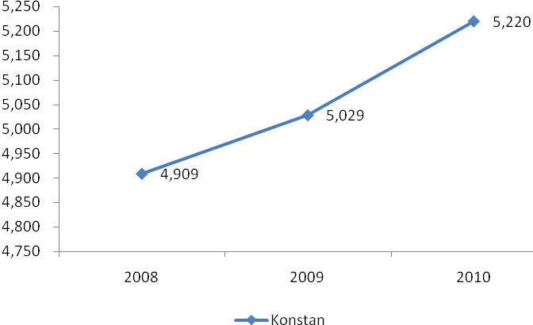
GDP Per Capita
Picture 1
GDP per capita District "X" (Yr. 2008-2010, thousands of rupiah)

Slide 9
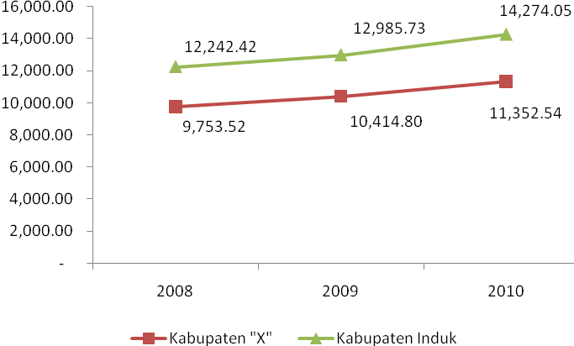
GDP Per Capita
Picture 2
GDP per capita District "X" and District “Parent”
Yr. 2008-2010 (thousands of rupiah).

Slide 10
GDP Per Capita
The GDP per capita of the District "X" after becoming an autonomous region new has increased from year to year. The GDP per capita at constant prices illustrates the real income District residents "X", in the year 2008 of Rp.4.909.290.- and in 2009 rose to Rp. 5.02867 million, - or grew by 2.43 percent. In 2010 rose to Rp. 5.22 million, - or grew by 3.80 percent. But if you use the World Bank standards, District of per capita GRDP figures "X" included in the category of "lower middle income".
According to The World Bank, That the lower middle-income countries (lower middle income) Is a country that has a per capita GDP of $ 1,026 to $ 4.0353. If the GDP per capita of the District "X" in comparison with the District Parent, long a daenew autonomous rah still far below the GDP per capita of the District Parent.

Slide 11
GDP Per Capita
The GDP per capita (at current prices) District "X" for Rp.9.753.520, - on 2008, while the District Parent as big as Rp. 12,242,428, -. The GDP per capita of the District "X" amount of Rp. 10.4148 million, -on 2009, while the District Parent as big as Rp.12.985.731, -, The GDP per capita of the District "X" amount of Rp. 11,352,549, -on 2010, while the principal district stood at Rp. 14,274,059, -.
Prowthhis The GDP per capita of the District "X" from 2008 to 2009 reached 6.78 percent and growth dari 2009 to 2010 reached 9.00 percent,

Slide 12
The GDP per capita by sub district
No. | sub-district | apply | Constant
1 | RG | 8,077,948.35 | 3,578,315.14
2 | GH | 9,858,272.18 | 4,386,856.72
3 | SK | 8,145,478.21 | 3,612,449.01
4 | CL | 8,100,295.32 | 3,672,005.92
5 | CH | 6,721,875.49 | 2,964,802.41
6 | CP | 7,904,547.29 | 3,475,252.12
7 | BJ | 16,621,378.44 | 7,462,497.26
8 | CPT | 9,151,998.20 | 3,963,500.78
9 | PL | 24,468,750.34 | 10,696,375.53
10 | NG | 8,557,579.25 | 5,424,133.65
11 | PP | 10,287,975.19 | 3,866,804.80
12 | LB | 11,901,160.56 | 5,185,737.99
13 | CS | 7,030,825.95 | 4,626,771.01
14 | CKW | 11,296,857.24 | 4,931,704.87
15 | CPD | 9,195,855.94 | 4,092,075.23
Regency. "X" |  | 11,352,549.28 | 5,193,302.15

Slide 13
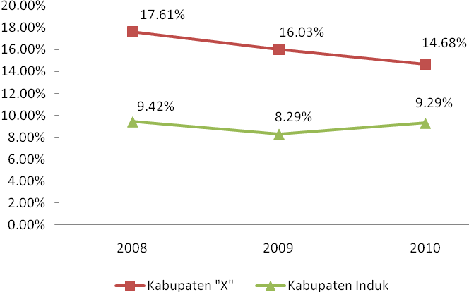
Level of Poverty

Slide 14
Level of Poverty
BPS approach in addressing the basic needs (basic needs approach).
Poverty seen as an economic inability to meet the basic needs of food and non-food which is measured from the expenditure side.
In this way the poor can be calculated percentage of the total population.

Slide 15
Level of Poverty
Poverty in the district of "X" in 2008-2010 decreased, but is still in the category "Levels of poverty high", In 2008 the number of poor people is 251 690 inhabitants (17.61 percent), In 2009 dropped to 232 690 inhabitants (16.03 percent)And in 2010 down again becomes 222 900 inhabitants (14.68 percent), So that dnatural period 2008 to 2010, poverty reduced a number of 28 790 inhabitants (2.93 percent),
percentage poor people in District "X" higher "high"when compared with the District Parent. In 2008, poor people in the District Parent amounted to 9.42 percent, P there in 2009 amounted to 8.29 per cent and in 2010 amounted to 9.29 percent. In 2008, the poverty line in the district of "X" amount of Rp. 167 326, -. In 2009 to Rp. 202 705, - and Rp. 216 388, - in 2010.
Poverty line is still far from the standards of the World Bank (per capita income of $ 2 per day), This means that if number the poverty line is raised, the percentage of poor people in the district of "X" will increase.

Slide 16
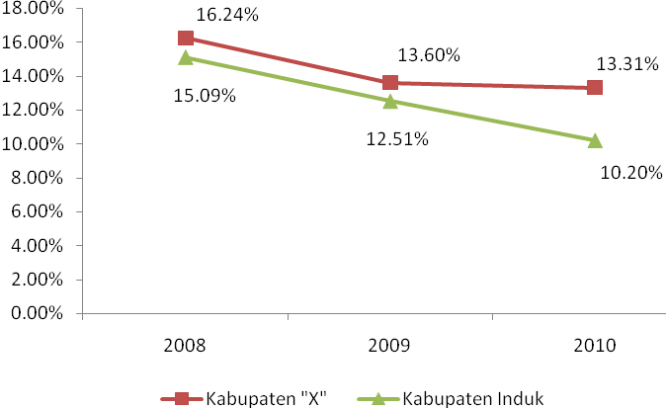
Level of Unemployment

Slide 17
Level of Unemployment
Unemployment = people who do not work at all, are looking for work, working less than two days during the week, or someone trying to get a job (CPM),
The level of Unemployment in the district of "X" still relatively high (on unnatural position)

Slide 18
Level of Unemployment
Level of unemployment in the district of "X" in 2008 amounted to 16.24 percent, while in the District Parent amounted to 15.09 percent. In 2009 to 13.60 in the district of "X" and The District Parent was reduced to 12.51 percent. PNo 2010 to 13.60 percent in the district of "X", while The District Parent was reduced to 10.20 percent. During three years, unemployment in the district of "X" is reduced to 2.93 per cent, while in the District Parent decreased by 4.89 percent.
The Efforts of Government;
Promoting training in order to improve the quality of human resources (HR).
Develop the entrepreneurial spirit of society in order to create new jobs, increase the mobility of labor and capital, the provision of labor market information (including district neighbor), As well as spur economic growth and equitable development,

Slide 19
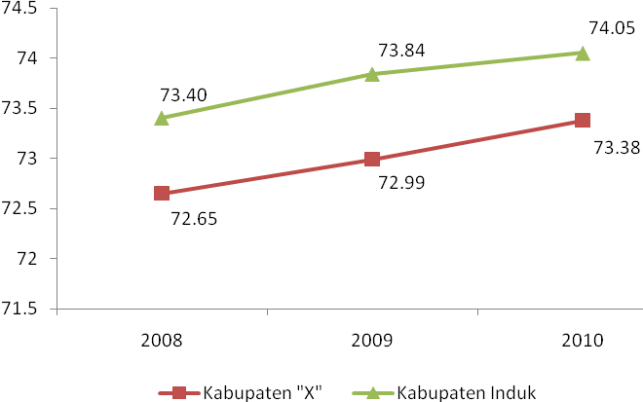
Human Development Index (HDI)

Slide 20
Human Development Index (HDI)
Human Development Index = achievement of progress in the fields of education, health and economy.
HDI was introduced in 1990. UNDP HDI includes three basic components for humans; be relatedthe chances of survival (Longevity), Knowledge (knowledge), And a decent life (decent living).
HDI is one indicator to measure the level of physical and non-physical quality of the population. Reflected in the physical quality of the life expectancy, while the non-physical (intellect) can be measured by the length of the average population of schooling and literacy rates. HDI also consider the economic ability as reflected in the value ofPurchasing Power Parity index (PPP).

Slide 21
Human Development Index
HDI District "X" has increased every yearhis as long as a new autonomous region, but still under the District Parent. On 2008, HDI District "X" stood at 72.65, the District Parent reach 73.40. On 2009, HDI District "X" reached 72.99, the District Parent on 73.84 figure. On 2010, the District Parent reaches 74.05, while HDI District "X" on figure 73.38,

Slide 22
Human Development Index by sub district
No. | sub-district | 2008 |  | 2009 |  | 2010
 |  | IPM | Pering- kat | IPM | Pering- kat | IPM | Pering- kat
1 | CL | 72.31 | 5 | 72.87 | 5 | 73.67 | 5
2 | CH | 72.13 | 7 | 72.58 | 7 | 73.24 | 7
3 | SK | 70.05 | 12 | 70.45 | 12 | 71.20 | 12
4 | GH | 68.71 | 13 | 69.00 | 13 | 69.72 | 13
5 | RG | 65.55 | 15 | 66.18 | 15 | 66.97 | 15
6 | CP | 66.7 | 14 | 67.41 | 14 | 68.23 | 14
7 | BJ | 72.17 | 6 | 72.78 | 6 | 73.59 | 6
8 | LB | 74.47 | 1 | 75.02 | 1 | 75.64 | 1
9 | PP | 73.27 | 2 | 73.77 | 2 | 74.44 | 2
10 | CS | 70.21 | 11 | 70.92 | 10 | 71.70 | 10
11 | NG | 72.47 | 4 | 72.95 | 4 | 73.85 | 4
12 | PL | 73.17 | 3 | 73.38 | 3 | 74.01 | 3
13 | CPT | 71.31 | 8 | 71.58 | 8 | 72.26 | 8
14 | CPD | 70.35 | 10 | 70.80 | 11 | 71.46 | 11
15 | CKW | 70.82 | 9 | 71.02 | 9 | 71.52 | 9

Slide 23
Summary
Todaro (2000) that development at least meet three basic components which cover; adequacy (sustenance) meet basic needs, improve self-esteem or self (self esteem)And freedom (freedom)to choose. KDistrict development inerja "X" can be categorized as a dimension "adequacy",
Facts show that new autonomous regions have not made a significant impact to the performance of the construction of the District "X". Especially if it is associated with Other aspects such as living environment.
In the future, to measure development performance should be developed at various performance indicators more comprehensive,
Development = Multidimensional and Various Complexities Problem.

Slide 24
Conclusion
From the above description can concluded that :
The implementation of the new autonomous region has not had a significant impact on the performance of the development of the District "X" in West Java.
It was shown by some indicators of development are:
The GDP per capita still low and still below District Parenthis, the gap in sub-district still see clearly;
The Level of poverty still quite high;
The Level of unemployment still high, in the category of unnatural;
HDI belong to the category of Moderat (66 <IPM <80) and there are three districts with HDI below the number 70, but the numbers HDI District "X" is still under District Parent,

Slide 25
_Thank you_

