Slide 1
CULTURAL ORGANIZATION, LEADERSHIP STYLE, AND SATISFACTION, AND ITS EFFECT ON THE PERFORMANCE OF EMPLOYEES (A Case Study in DKI Jakarta PTM)
BY:
Berlianingsih Kusumawati, SE, MM
Dra. Seti sulistyo Utami, MM
Adi Musharianto, SE, MM

Slide 2
PRELIMINARY
PTM as private education providers continue to compete in providing educational services, either with PTS or PTN;
Work culture will influence behavior, if the work culture in PTM is good, then it will be good too PTM itself and vice versa. For example, culture of discipline, lack of discipline in the PTM is a bad culture for PTM, Conflict among employees was often caused less communicative leadership style and interactive between leaders and subordinates, thus greatly influence the behavior of their subordinates.
The many activities outside leadership office make less of a leader can effectively manage and control and direct its activities in the institution.
One way that can be done to obtain and maintain customer satisfaction (students) is to maintain and improve the performance of employees through workplace culture, leadership, satisfaction with the performance of employees.

Slide 3
PURPOSE
Menganalisisi influence of organizational culture on employee satisfaction;
Analyzing the influence of organizational culture on employee performance;
Analyzing the effect of leadership style on employee satisfaction;
Analyzing the effect of leadership style on employee performance;
Analyzing the influence of employee satisfaction on the performance of karayawan.

Slide 4
THEORETICAL FRAMEWORK
Budaya Organisasi
Sistem makna bersama yang diselenggarakan oleh anggota yang membedakan satu organisasi dengan organisasi lain (Robbins dan Judge, 2011).
Perangkat dalam budaya organisasi: velues, beliefs , assumtions, atau norma yg disepakati dan diikuti oleh para anggota suatu organisasi (Sutrisno, 2010).
Gaya Kepemimpinan
Norma perilaku yang digunakan oleh seseorang pada saat orang tersebut mencoba mempengaruhi perilaku orang lain seperti yang ia lihat (Thoha, 2013)
Pola perilaku dan strategi yang disukai dan sering diterapkan oleh seorang pemimpin (Rivai, 2014
Kepuasan Karyawan
Cara individu merasakan pekerjannya yang dihasilkan dari sikap individu tersebut terhadap berbagai aspek yang terkandung dalam pekerjaan (Suwarno dan Priansa, 2011).
Kinerja Karyawan
Cara individu merasakan pekerjannya yang dihasilkan dari sikap individu tersebut terhadap berbagai aspek yang terkandung dalam pekerjaan (Suwarno dan Priansa, 2011).

Slide 5
PREVIOUS RESEARCH
Organizational culture has a positive effect on job satisfaction and employee performance (Wiliam, 2014; Nugroho, 2011; and Kusdiyanto, 2011);
Leadership Style positive effect on satisfaction and employee performance (Mariam 2009; Firmansyah, (2008); Riyadi (2011); and (Nafrizal, et al., 2012);
Signifiakan employee satisfaction has a positive effect on employee performance (Maryani; 2011); Generous,et al., 2012; and Nur 2013).

Slide 6
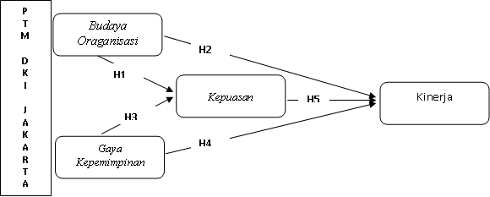
Framework Thought and hypothesis
H1 Culture organisasiberpengaruh poisitif on employee satisfaction;
H2 : Organizational culture has a positive effect on employee performance;
H3 : Leadership style has a positive effect on employee satisfaction;
H4 : Leadership Style positive effect on employee performance;
H5 Satisfaction employees' positive influence on employee performance.

Slide 7
RESEARCH METHODS
variables | Indicator
Organizational culture (Robbins, 2010) | Institution employees demanding in terms of accuracy, analysis, and attention to detail Institutions emphasize the achievement of the objectives (outcomes) from the way of achieving goals (procession) Instiusi willing to consider human factors (employees) in the management decision making Institutions emphasis on group work (team), rather than individual work in completing the task - the task Institutions encourage our employees to be innovative and bold mengambli risk Institution insists on maintaining the status quo in making decisions and actions.
Leadership style (Hersey & Blanchard, 2011) | My boss is always watching what subordinates do My boss always perform specific directives Bosses are willing to hear the opinion or advice of subordinates Communication between subordinates and superiors excellent Bosses always involve subordinates and co-workers in making decisions Bosses always evaluate my work and colleagues Bosses always explain new tasks to employees
Employee satisfaction (Herzberg in Suprayetno 2008) | Satisfied with the salary or wages granted by the company Recitals are always on time Equipment used in the work is complete and sophisticated Facilities provided by the company is good enough Satisfied with the environmental conditions (such as temperature, light, air circulation, etc.) Getting to comply with rules made by the company System administration is supporting the work activities of employees The performance assessment is done objectively by the company The company gives a chance to to a higher career level Employees of the company have the opportunity to show his skills
Employee Performance (Mathis & Jackson, 2014) | The concerned employees can complete tasks more than the company's target The employees concerned can resolve issues quickly work The results of the employee concerned in accordance with the quality of work that has been determined The results of the employee concerned duties do not ever let the company Employees always arrive earlier than office hours Employees can divide breaks in work
Data Research:
Primary (employee PTM Jakarta 100 respondents) through questionnaires dg scale linkert,
Test Instrument:
Test validity and reliability
Technique analysis:
structural equation Modeling (SEM) use software SmaRTPLS

Slide 8
RESEARCH RESULT
Profile respondents
54, 54%
46, 46%
institutions
Gender
Age respondents

Slide 9
Validity and Reliability Test
item | Correlation value |  |  |  | Ket
 | X1 | X2 | X3 | Y
1 | 0547 | 0545 | 0921 | 0860 | valid
2 | 0523 | 0534 | 0976 | 0875 | valid
3 | 0850 | 0870 | 0876 | 0943 | valid
4 | 0543 | 0543 | 0548 | 0845 | valid
5 | 0687 | 0435 | 0943 | 0543 | valid
6 | 0543 | 0843 | 0:45 | 0765 | valid
7 |  | 0524 | 0876 |  | valid
8 |  | 0554 | 0653 |  | valid
9 |  |  | 0983 |  | valid
10 |  |  | 0974 |  | valid
No. | variables | Cronbach's alpha | Information
1 | BudayaKerja (X1) | 0.945 | reliable
2 | Leadership (X2) | 0,981 | reliable
3 | Performance (X3) | 0.878 | reliable
3 | Satisfaction (Y) | 0,964 | reliable

Slide 10
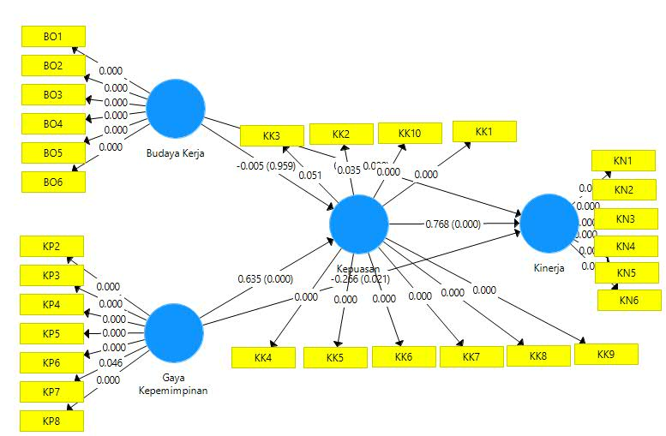
Construct Model dg Research SmartPLS

Slide 11
convergent Validity
 | Original Sample estimate |  | Original Sample estimate
BO1 | 0.876 | KK10 | 0,900
Bo2 | 0.768 | KN1 | 0,745
BO3 | 0.667 | KN2 | 0.905
BO4 | 0.712 | KN3 | 0.868
BO5 | 0.761 | KN4 | .789
BO6 | 0.683 | KN5 | .760
KK1 | 0.726 | KN6 | 0,745
KK2 | .673 | KP2 | .566
KK3 | .654 | KP3 | .834
KK4 | 0.835 | KP4 | 0.904
KK5 | 0.658 | KP5 | .853
KK6 | 0.733 | KP6 | .757
KK7 | 0.721 | KP7 | .528
KK8 | .786 | KP8 | 0.916
KK9 | .830
convergent Validity explaining hiti the ability of each indicator in explaining the variables studied.convergent Validity as valid apabilanilai loading lebihdari 0.7. Nevertheless,convergent Validity below 0.7, which is between 0.5 to 0.6 can be tolerated.

Slide 12
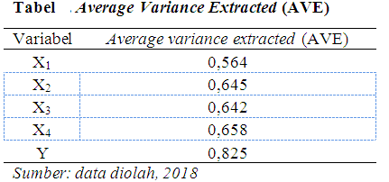
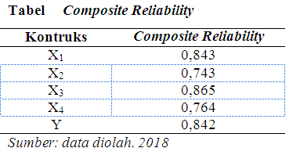
An indicator otherwise meet discriminant validity if the value of cross loading indicators on the variables is the largest compared to the other variables, or an AVE value greater than 0.5.
composite reliability measure internal consistency, According to Ghazali (2011) valuecomposite reliability should be above 0.6.

Slide 13
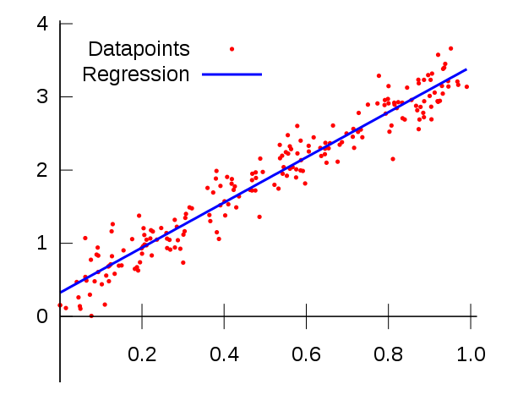
Test Goodness of Fit
Test goodness of fit it can be seen from the value of Q-Square, the higher it isQ-Square, Then the model can be said to be better or more fitwith data. ScoreQ-Square can be calculated as follows: 1 - [(1 - R²1) x ((1 - R²2). Previously known that R-Square for the satisfaction of employees is 0.453, and for the performance of employees is 0.642. So the value of the Q-Square is 0.804. Q-Square has a sense of the magnitude of the diversity of the research data that can be explained by the model of research amounted to 80.4%. While the rest is explained by other factors that are beyond our model.

Slide 14
HYPOTHESIS TEST
H1 : Cultural organizations poisitif effect on employee satisfaction (BE ACCEPTED);
H2 : Organizational culture has a positive effect on employee performance (BE ACCEPTED);
H3 : Leadership style has a positive effect on employee satisfaction (BE ACCEPTED);
H4 : Leadership Style positive effect on employee performance (BE ACCEPTED);
H5 Satisfaction employees' positive effect on employee performance (BE ACCEPTED),

Slide 15
CONCLUSION
Budaya organization on employee satisfaction has a coefficient of 0.005 with signifiasi value (P value) Amounted to 0,034. Thus the organizational culture significant positive effect on employee satisfaction. The stronger the organizational culture to increase employee satisfaction meal;
Organizational culture has a coefficient of 0.413 with p vlue0,000 on employee performance. Signisfikan organizational culture has a positive effect on employee performance, the stronger the culture of the organization, employee satisfaction will increase;
Leadership style significant positive effect on satisfaction karyaran. Coefficient of leadership style on employee satisfaction at 0.649 with pvlue0,000. The better the leadership style meal will increase employee satisfaction;
The leadership style of the performance of the employees have a coefficient of 0.267 with p vlueamounted to 0,021. With a leadership style demikikan significant positive effect on employee performance. Good leadership style will enhance employee performance;
Coefficient of employee satisfaction on the performance of employees is 0.768 with p vlue 0,000. Values ​​are addressed there is a significant positive influence on employee satisfaction to employee performance. The higher employee satisfaction then the performance will increase.

