Slide 1
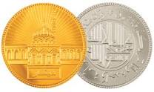
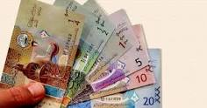
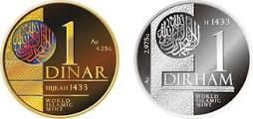
ANALYSIS OF CASH WAQF ACCOUNTING STANDARDS
IN INDONESIA
AMRIZAL
NINIS ELSAWATI
AZWAR

Slide 2
New Standard
PSAK 112
CASH WAQF IS CURRENT ISSUE
BADAN WAKAF
INDONESIA
Implement
2021
Regulation
Problem

Slide 3
To analyze the accounting treatment of cash waqf
To analyze risk and cash waqf
The Objective of research
To Analyze Cash waqf accounting treatment

Slide 4
The research proves Al-Azhar and Dompet Dhuafa foundation have be done PSAK 112 but not referring to the Islamic financial accounting standards No. 112
Research
result
Risk potential of Cash waqf, is very big because of regulation and inadequate supporting instruments including business risk
Islamic financial accounting standards do not regulate the accounting treatment of cash waqf permanent toward inflation

Slide 5
Implications of the study is expected to be a concern for the interested parties to complete endowment accounting and prepare regulations in order to make endowments as economic pillars of Islam
THANKYOU

