Slide 1

ICONHADY
2020
ITB AHMAD DAHLAN JAKARTA

Slide 2

Arranged by:
Mr. Anggi Moch Taufik
NIM : 2018114520022
Author:
Mr. Amrizal, SE, MM, Ph.D

Slide 3


TITLE
FACTOR ANALYSIS TABARRU CONTRIBUTIONS, CLAIMS, REINSURANCE CONTRIBUTIONS AND TECHNICAL RESERVE ON
UNDERWRITING SURPLUS
OF SHARIA LIFE INSURANCE IN INDONESIA

Slide 4
Executive Summary
1
2
3
This study aims to determine the effect of the tabarru contributions, claims, reinsurance contributions and technical reserve on underwriting surplus sharia life insurance and analyze the effect simultaneously or partially
The location of the study was conducted in Indonesia based on sharia life insurance data both pure sharia and sharia units in Indonesia from 2014 to 2018 (5 years).
The method used in this study is a quantitative research approach, with testing using multiple linear regression analysis

Slide 5
Background
3

Slide 6
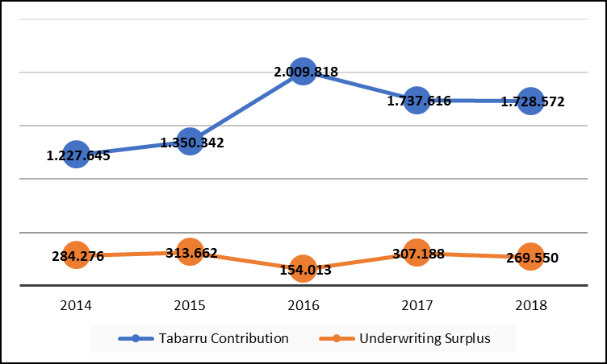
Background
3

Slide 7
Problem and Research purposes
Problem
Is tabarru contributions affect the underwriting surplus on sharia life insurance in Indonesia?
Research purposes
Analyzing the influence tabarru contributions to the underwriting surplus on sharia life insurance in Indonesia.
Is claims affect the underwriting surplus on sharia life insurance in Indonesia?
Is reinsurance contributions affect the underwriting surplus on sharia life insurance in Indonesia?
Is a technical reserve affect the underwriting surplus on sharia life insurance in Indonesia?
Are tabarru contributions, claims, reinsurance contributions, and technical reserve simultaneously affect the underwriting surplus on sharia life insurance in Indonesia?
Analyzing the influence claims to the underwriting surplus on sharia life insurance in Indonesia.
Analyzing the influence reinsurance contributions to the underwriting surplus on sharia life insurance in Indonesia.
Analyzing the influence of technical reserve to the underwriting surplus on sharia life insurance in Indonesia.
Analyzing the influence of tabarru contributions, claims, reinsurance contributions, and technical reserve simultaneously to the underwriting surplus on sharia life insurance in Indonesia.
1
2

Slide 8
Sampling Method
The sampling technique used in this study was purposive sampling technique
Population and Sample
The population used in this study is sharia life insurance companies in Indonesia, amounting to 30 companies
The sample used is 10 Sharia life insurance companies with a period of 2014 to 2018.
Research object
Data Type
Secondary data
TABARRU CONTRIBUTIONS
Financial data obtained from sharia life insurance company financial statements from 2014 - 2018
CLAIMS
REINSURANCE CONTRIBUTIONS
TECHNICAL RESERVE
UNDERWRITING SURPLUS

Slide 9
Hypothesis
H1
Tabarru Contributions significantly affect the underwriting surplus on sharia life insurance in Indonesia
H2
Claims significantly affect the underwriting surplus on sharia life insurance in Indonesia
H3
Reinsurance Contributions significantly affect the underwriting surplus on sharia life insurance in Indonesia
H4
Technical Reserve significantly affect the underwriting surplus on sharia life insurance in Indonesia
H5
Tabarru Contributions, Claims, Reinsurance Contributions and Technical Reserve significantly influence the underwriting surplus on sharia life insurance in Indonesia

Slide 10
Conceptual Model
Multiple linear regression equation:
Y = α + β₁ X₁ + β₂ X₂ + β₃ X₃ + β₄ X₄
The variables used in this study can be identified into 2 (two) variables, namely:
Independent Variable (X) :
X1 – Tabarru Contributions
X2 – Claims
X3 – Reinsurance Contributions
X4 – Technical Reserve
Dependent Variable (Y) :
Underwriting Surplus
Tabarru Contributions
X1
H1
Underwriting Surplus
Claims
H2
X2
H3
Y
Reinsurance Contributions
Y
X3
H4
Technical Reserve
H5
X4
Partial
Simultaneous

Slide 11
Coefficient of Determination
R : 0,819
shows that the degree of relationship (correlation) between the independent variable with the dependent variable is 81.9%, so it can be concluded that there is a very strong relationship between the dependent variable and the independent variable.
Adjusted R²: 0,641
this means that 64.1% of the dependent variable that is the underwriting surplus can be explained by the variation of the independent variables namely the tabarru contributions, claims, reinsurance contributions and technical reserve

Slide 12
Partial test (t-test)
Variable | t table α : 5% | t hitung | sig. value | Decision
Tabarru Contributions | 2,041 | 7,429 | 0,000 | t count 7,429 > t table 2,014 and significant value 0,000 < 0,05, H0 rejected and H1 accepted
Claims | -2,041 | -2,711 | 0,009 | t count -2,711 < t table -2,014 and significant value 0,009 < 0,05, H0 rejected and H1 accepted
Reinsurance Contributions | -2,041 | -1,073 | 0,289 | t count -1,073 > t table -2,014 and significant value 0,289 > 0,05, H0 accepted and H1 rejected
Technical reserve | -2,041 | -2,178 | 0,035 | t count -2,178 < t table -2,014 and significant value 0,035 < 0,05, H0 rejected and H1 accepted

Slide 13
Simultaneous test (F-test )
F table α : 5% | 2,58
F count | 22,837
sig. value | 0,000
Decision | F count 22.837 > F table 2.58 and significance value 0.000 <0.05 so decided to reject H0 and accept H1 That means tabarru contributions, claims, reinsurance contributions and technical reserve together or simultaneously significant effect on sharia life insurance underwriting surplus in Indonesia at the 5% significance

Slide 14
Conclusion
Tabarru contributions partially positive and significant effect on the sharia life insurance underwriting surplus in Indonesia, based on the results of multiple regression analysis with t count 7.429 > t table 2.014 and significant value 0.000<0.05, then H0 rejected and H1 accepted.
Claims partially negative and significant effect on sharia life insurance underwriting surplus in Indonesia, based on results of multiple regression analysis t counts -2.711 > t table -2.014 and significant value 0.009 <0.05, then H0 rejected and H1 accepted
Reinsurance contributions partially no effect on sharia life insurance underwriting surplus in Indonesia, based on results of multiple regression analysis t counts -1.073 > t table -2.014 and significant values 0.289> 0.05, then H0 accepted and H1 rejected

Slide 15
Conclusion
Technical reserve partially negative and significant effect on sharia life insurance underwriting surplus in Indonesia, based on results of multiple regression analysis t count -2.178 <t table -2.014 and significant value 0.035 <0.05, then H0 rejected and H1 accepted
Tabarru contributions, claims, reinsurance contributions and technical reserve together or simultaneously significant effect on sharia life insurance underwriting surplus in Indonesia at the 5% significance to the model equation Y = - 1942.792 + 0,384 X1 - 0.191 X2 - 0.084 X3 - 0.063 X4

Slide 16

Thank You

