Slide 1
By
Berlianingsih Kusumawati SE, MM
Dra. Sulistiyo Seti Utami MM
Ermalina SE, MM
"The influence of Porter's Five Forces Model
(Porter's Five Forces Model)
Against Competitive Advantage In
Cooperatives and SMEs in South Tangerang city "
ITB AHMAD DAHLAN JAKARTA

Slide 2
Background Problem
Micro small and Medium Enterprises
Presidential Decree No. 99 of 1998
Small and medium business operators who have built up in 1700 comprising 371 cooperatives and SMEs (Dipkop Tangsel, 2017)
Strategy porter's five forces (Porter's Five-Forces Model)

Slide 3
Strategy porter's five forces (Porter's Five-Forces Model):
Competition among peers
The possible entry of new competitors
Potential development of substitute products
Bargaining power sellers / suppliers
Bargaining power of buyers / consumers
competitive advantage

Slide 4
Formulation of the problem :
How much influence the entry of competition similar companies to competitive advantage at the Department of Cooperatives and SME South Tangerang City?
How much influence the possible entry of new competitors on competitive advantage on Cooperatives and SME South Tangerang City?
How much influence the potential development of products to competitive advantage at the Department of Cooperatives and SME South Tangerang City?
How much influence the bargaining power to competitive advantage at the Department of Cooperatives and SME South Tangerang City?
How much influence the bargaining power of buyers / consumers to competitive advantage at the Department of Cooperatives and SME South Tangerang City?
Research purposes:
To calculate the effect of the entry of competition similar companies on competitive advantage on Cooperatives and SME South Tangerang City.
To calculate the effect of the possible entry of new competitors on competitive advantage on Cooperatives and SME South Tangerang City.
To calculate the effect of the potential development of products to competitive advantage at the Department of Cooperatives and SME South Tangerang City.
To calculate the effect of bargaining power on competitive advantage on Cooperatives and SME South Tangerang City.
To calculate the effect of bargaining power of buyers / consumers to competitive advantage at the Department of Cooperatives and SME South Tangerang City?

Slide 5
LITERATURE REVIEW
MSMEs
Based on Law No. 20 Year 2008 on Micro, Small and Medium Enterprises (SMEs) there are several criteria used to define the terms and criteria for SMEs
Micro business
Productive enterprises owned by individuals or entities belonging to individual or business entity owned by individuals who meet the criteria are:
Has a net worth of at most Rp 50,000,000 (fifty million rupiahs), excluding land and buildings
Having an annual sales turnover of Rp. 300,000,000 (three hundred million rupiah)

Slide 6
Small business
Productive economic activities were isolated and perpetrated by individuals or entities that are not subsidiaries or branches of companies owned, controlled, or be a part either directly or indirectly from medium or large businesses that meet the criteria of small businesses that are regulated in the enactment Act. Its criteria are:
Have a net worth of more than Rp. 50,000,000 (fifty million rupiah) up to Rp. 500,000,000 (five hundred million rupiah) not including land and buildings; or
Having annual sales revenue of more than Rp 300,000,000 (three hundred million rupiah) up to at most Rp 2,500,000,000 (two billion five hundred million rupiah)

Slide 7
Medium Enterprises
Productive economic activities that stand alone, which is carried out by individuals or entities that are not subsidiaries or branches of companies owned, controlled, or be a part either directly or indirectly with a small business or large enterprise with total net assets or annual sales revenue as is set in the legislation. Which has the following criteria:
Have the result of net worth of more than Rp 500,000,000 (five hundred million rupiah) up to at most Rp 10,000,000,000 (ten billion rupiahs), excluding land and buildings; or
Having annual sales revenue of more than USD 2.5 billion (two billion five hundred million rupiah) up to at most Rp 50,000,000,000 (fifty billion rupiah).

Slide 8
COOPERATIVE
Moh.Hatta are falling cooperative is a joint effort to improve the lot of economic livelihoods by helping. The spirit of helping each other is driven by the desire to give service by a comrade kepda for all and all for one.
DEPARTMENT OF COOPERATION
Service cooperatives and micro-businesses are implementing elements of government affairs cooperatives and micro areas of the regional authority.

Slide 9
Strategy
According to the Greek strategy strategos which means general. A mempunai basics strategy or scheme to reach the intended target. So, basically makes a means to an end.
Strategic Management
The term strategic management refers to the formulation, implementation, and evaluation. The goal of strategic management is to exploit and create new opportunities are different in the future, long-term planning, on the contrary, trying to optimize the present trend for the future

Slide 10
Competitive advantage
Strategic management is about gaining and maintaining a competitive advantage (competitive advantage). This terminology can be defined as "everything was done very well by a company against its competitors".
When a company can do something and the other companies can not or have something to be desired competitors, it illustrates the advantage competitively. Has a very important competitive advantage for the long term success of an organization.

Slide 11
Competitive analysis: Porter's Five Forces Model
Competition among peers
The possible entry of new competitors
The potential development of substitute products
Bargaining power sellers / suppliers
Bargaining power of buyers / consumers

Slide 12
Competitive Advantage
According to Porter(1994) in research Suparyadi (2003: 146) explains that "the competitive advantage is the concept of competitive advantage can not be understood by way of looking at a company as a whole, but must be of the origin of competitive advantage was that the various activities of different undertaken by the company in designing, produce, market, deliver and support its products ". Therefore, in order to face competition from day to day getting tight, so every company must be able to read the opportunities of its competitive advantage.

Slide 13
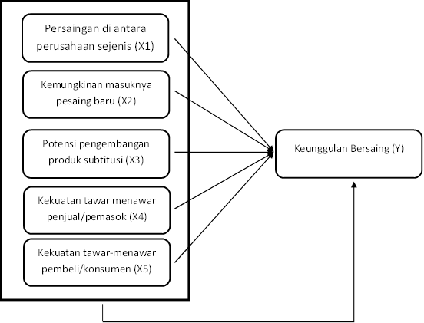
RESEARCH METHODOLOGY
Picture 1 Constructs Variables Research

Slide 14
identification Variables
variables | Dimension | Indicator | size Scale
Development Strategy Competitive Analysis (Porter's Five Forces Model) in SMEs and Medium Enterprises in South Tangerang | Competitors among its peers (X1) | Product quality | Likert
 |  | Marketing via the Internet | Likert
 |  | The corporate culture | Likert
 | Entry of new competitors (X2) | Lack of experience | Likert
 |  | The high customer loyalty | Likert
 |  | The strong preference for the brand | Likert
 |  | Lack of distribution channels | Likert
 |  | Government regulations | Likert
 |  | Technology and specialized knowledge | Likert
 |  | Location unfavorable | Likert
 |  | The amount of capital needs | Likert

Slide 15
 | The potential development of substitute products (X3) | Gained market share | Likert
 |  | Plan the capacity of the company | Likert
 | Bargaining power sellers / suppliers (X4) | The price given | Likert
 |  | Improve Quality | Likert
 |  | Develop new services | Likert
 |  | Delivery of just-in-time | Likert
 | Bargaining power of buyers / consumers (X5) | The selling price of the product | Likert
 |  | product warranty | Likert
 |  | The product package | Likert
 |  | Discount via online application (Internet) | Likert
 | Competitive Advantage (Y) | Something important to kosumen | Likert
 |  | Something distinctive and unique
 |  | worth Superior
 |  | easily communicated
 |  | Something new / pioneer
 |  | Affordable (purchasing power)
 |  | Will benefit
Source:
Fred r. David, 2006, StrategicManagement (Variable X)
Source:
Kotler, 2003, the Competitive Advantage (Variable Y)

Slide 16
Validity and Reliability Test
Test the validity necessary to ensure that inquiries are made to reflect the dimensions to be measured. If the data were obtained from the use of scale Linkert keusioner assumed an interval data, then the validity of the test is done through correlation testPearson Product Moment, However, if the data were obtained from questionnaires using assumed Linkert scale is ordinal data, the data must be first converted into an interval scale using methods successive intervals(Algifari, 2015). Because the data in this study is the data inverval, the reliability of the questions in the questionnaire this study dilakuka through correlation testPearson Product Moment use SPSS software, Item dikatan question is valid if the correlation value of each variable over 0.3,

Slide 17
RELIABILITY TEST
Reliability test used in this study to obtain reliable information used as a means of data collection and to reveal the actual information field. According Ghozali (2009), is a tool to measure the reliability of a questionnaire which is an indicator of variables or constructs. A questionnaire said to be reliable or reliable if someone answers on the statement is consistent or stable over time. The reliability of a test refers to the degree of stability, consistency, predictability, and accuracy. Measurements have high reliability is a measurement that can generate data that reliable.Untuk measure the validity and reliability of research instrument is assisted bysoftwareSPSS. Kuesioer its reliable or not used can be seen from theCronbach's Alpha, Questionnaires dikatan reliable if the valueCronbach's Alpha of at least 0.6.

Slide 18
DATA ANALYSIS TECHNIQUE
Successive Interval Methode (MSI)
Respondents of the questionnaire is in the form of raw data ordinal scale. So as to be processed by the next method is the method of Path Analysis (path Analysis) Required the transformation of data, where data obtained ordinal scale is transformed into a form of interval scale data by using methods Successive Interval Methode (MSI).

Slide 19
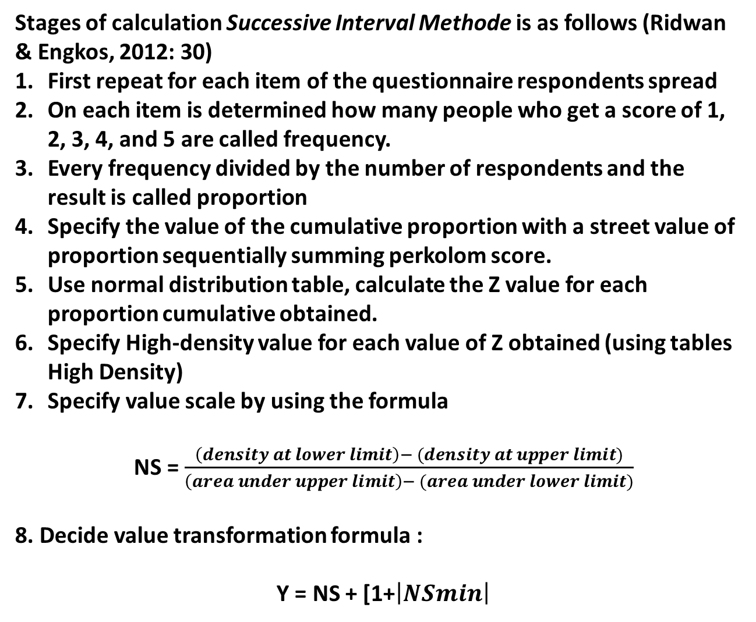
Stages of calculation Successive Interval Methode is as follows (Ridwan & Engkos, 2012: 30)
First repeat for each item of the questionnaire respondents spread
On each item is determined how many people who get a score of 1, 2, 3, 4, and 5 are called frequency.
Every frequency divided by the number of respondents and the result is called proportion
Specify the value of the cumulative proportion with a street value of proportion sequentially summing perkolom score.
Use normal distribution table, calculate the Z value for each proportion cumulative obtained.
Specify High-density value for each value of Z obtained (using tables High Density)
Specify value scale by using the formula
NS = $\frac{\left(density at lower limit\right)− (density at upper limit)}{\left(area under upper limit\right)− (area under lower limit)}$
8. Decide value transformation formula :
Y = NS + [1+$\left|NSmin\right|$

Slide 20
Path Analysis
The steps of data processing using path analysis method (path Analysis) are as follows :
Draw diagram lane
Calculation correlation matrix between variable
Calculation analysis lane
Calculation coefficient determination
Calculate variables outside variables investigated
examination simultaneously

Slide 21
PROFILE OF RESPONDENTS
The object of this study is the small businesses that are in the South Tangerang City. The samples used in this study were 125 respondents.

Slide 22
DEMOGRAPHIC CHARACTERISTICS OF RESPONDENTS
Information | Criteria | Frequency | Percentage
Gender | Male | 60 | 48
 | woman | 65 | 52
 | Σ | 125 | 100
Age | 16-25 | 35 | 28
 | 26-35 | 22 | 17.6
 | 36-45 | 19 | 15.2
 | 46-55 | 27 | 21.6
 | 56-66 | 13 | 10.4
 | 66-75 | 9 | 7.2
 | Σ | 125 | 100
Education | SD | 11 | 8.8
 | SMP | 27 | 21.6
 | High School | 53 | 42.4
 | Diploma / Bachelor | 29 | 23.2
 | more | 5 | 4
 | Σ | 125 | 100
old Business | <1 Year | 19 | 15.2
 | 1-2 Years | 33 | 26.4
 | 3-5 Years | 31 | 24.8
 | 6-10 Years | 21 | 16.8
 | 10-20 Years | 10 | 8
 | > 20 Years | 11 | 8.8
 | Σ | 125 | 100
Labor | <5 Workers | 104 | 83.2
 | > 5 Workers | 21 | 16.8
 | Σ | 125 | 100
Turnover Effort | <5 million / month | 51 | 40.8
 | 5-10 million / month | 34 | 27.2
 | 10-20 million / month | 14 | 11.2
 | 20-50 million / month | 16 | 12.8
 | > 50 million / month | 10 | 8
 | Σ | 125 | 100

Slide 23
SMEs in South Tangerang SMEs still dominated by women is about 52% and as much as 48% of SMEs male sex.
The majority of these SMEs were in the age range that are no longer productive or old quarters of the age group 46-55 years to reach 22% of the population, aged 56-65 (10%), and 7% of age 66-75 years. At the level of productive age, 18% are aged 26-35 and 36-45 years of age only 15%. While SMEs aged 16-25 years by 28%.

Slide 24
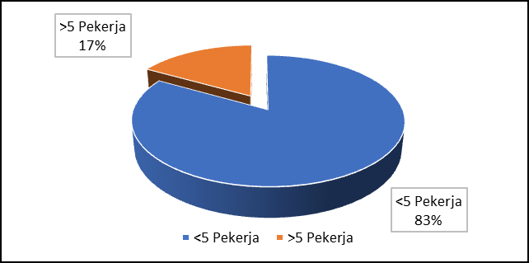
Picture Education respondents
Picture Long Effort respondents
image Power Respondents Enterprises Working
Pictures turnover Respondents Enterprises

Slide 25
VALIDITY TEST RESULTS
Table result Questions Validity Item Competition Between Peers (X1)
item Question | corrected Item total Correlation | cut Off | Information
X1_1 | 0561 | 0:30 | valid
X1_2 | 0599 | 0:30 | valid
X1_3 | 0610 | 0:30 | valid
X1_4 | 0640 | 0:30 | valid
X1_5 | 0687 | 0:30 | valid
X1_6 | 0696 | 0:30 | valid
Validity of Test Results Table Item Question Possible Entry of New Competitors (X2)
item Question | corrected Item total Correlation | cut Off | Information
X2_1 | 0670 | 0:30 | valid
X2_2 | 0591 | 0:30 | valid
X2_3 | 0644 | 0:30 | valid
X2_4 | 0613 | 0:30 | valid
X2_5 | 0589 | 0:30 | valid
X2_6 | 0587 | 0:30 | valid
X2_7 | 0588 | 0:30 | valid
X2_8 | 0588 | 0:30 | valid

Slide 26
Validity of Test Results Table Item Questions
Potential Development of Substitute products (X3)
item Questions | corrected Item total Correlation | cut Off | Information
X3_1 | 0843 | 0:30 | valid
X3_2 | 0798 | 0:30 | valid
X3_3 | 0770 | 0:30 | valid
X3_4 | 0808 | 0:30 | valid
Validity of Test Results Table Item Questions Strength of bargaining sellers / suppliers (X4)
item Questions | corrected Item total Correlation | cut Off | Information
X4_1 | 0725 | 0:30 | valid
X4_2 | 0736 | 0:30 | valid
X4_3 | 0748 | 0:30 | valid
X4_4 | 0675 | 0:30 | valid
X4_5 | 0761 | 0:30 | valid

Slide 27
Table result Validity Item Questions Strength of bargain shoppers / consumers (X5)
item Questions | corrected Item total Correlation | cut Off | Information
X5_1 | 0780 | 0:30 | valid
X5_2 | 0747 | 0:30 | valid
X5_3 | 0667 | 0:30 | valid
X5_4 | 0729 | 0:30 | valid
X5_5 | 0700 | 0:30 | valid
Table result Item Questions Validity Competitive Advantage (Y)
item Questions | corrected Item total Correlation | cut Off | Information
Y_1 | 0687 | 0:30 | valid
Y_2 | 0696 | 0:30 | valid
Y_3 | 0795 | 0:30 | valid
Y_4 | 0736 | 0:30 | valid
Y_5 | 0691 | 0:30 | valid
Y_6 | 0683 | 0:30 | valid
Y_7 | 0700 | 0:30 | valid
Y_8 | 0780 | 0:30 | valid

Slide 28
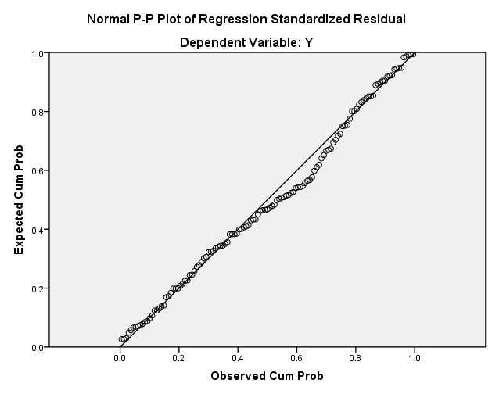
Cronbach's Alphaz | N of Items
.970 | 36
RELIABILITY TESTING
 |  | Residual unstandardized
N |  | 125
Normal Parameters^{a, b} | mean | .0000000
 | Std. deviation | 2.22667014
Most Extreme Differences | Absolute | .079
 | positive | .079
 | negative | -.030
Kolmogorov-Smirnov Z |  | .885
Asymp. Sig. (2-tailed) |  | .414
NORMALITY TEST
Normality Test Results (Normal P-Plot of Regression Standardized Residual)

Slide 29
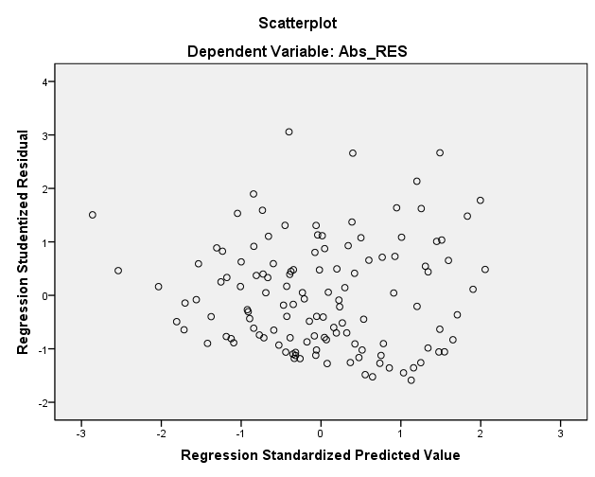
Test Results Heteroskidastity (scatterplot)

Slide 30
TEST RESULTS multikolinearitas
Model |  | Coefficients unstandardized |  | standardized Coefficients | t | Sig. | collinearity Statistics
 |  | B | Std. Error | beta |  |  | tolerance | VIF
1 | (Constant) | 1384 | 1,351 |  | 1,025 | .308
 | X1 | .197 | .098 | .165 | 2,019 | .046 | .245 | 4,081
 | X2 | .190 | .087 | .165 | 2183 | .031 | .289 | 3463
 | X3 | .357 | .150 | .225 | 2,380 | .019 | .185 | 5411
 | X4 | .275 | .101 | .213 | 2,716 | .008 | .268 | 3,730
 | X5 | .426 | .117 | .327 | 3,644 | .000 | .204 | 4894

Slide 31
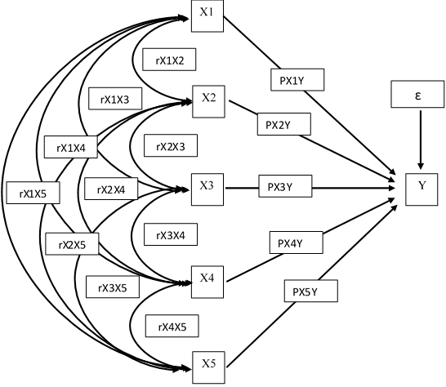
CHART ANALYSIS OF LANE

Slide 33
CORRELATION MATRIX
 |  | X1 | X2 | X3 | X4 | X5 | Y
X1 | Pearson Correlation | 1 | .812** | .507** | .317** | .262** | .562**
 | Sig. (2-tailed) |  | .000 | .000 | .000 | .003 | .000
 | N | 125 | 125 | 125 | 125 | 125 | 125
X2 | Pearson Correlation | .812** | 1 | .449** | .344** | .335** | .578**
 | Sig. (2-tailed) | .000 |  | .000 | .000 | .000 | .000
 | N | 125 | 125 | 125 | 125 | 125 | 125
X3 | Pearson Correlation | .507** | .449** | 1 | .799** | .832** | .821**
 | Sig. (2-tailed) | .000 | .000 |  | .000 | .000 | .000
 | N | 125 | 125 | 125 | 125 | 125 | 125
X4 | Pearson Correlation | .317** | .344** | .799** | 1 | .826** | .773**
 | Sig. (2-tailed) | .000 | .000 | .000 |  | .000 | .000
 | N | 125 | 125 | 125 | 125 | 125 | 125
X5 | Pearson Correlation | .262** | .335** | .832** | .826** | 1 | .790**
 | Sig. (2-tailed) | .003 | .000 | .000 | .000 |  | .000
 | N | 125 | 125 | 125 | 125 | 125 | 125
Y | Pearson Correlation | .562** | .578** | .821** | .773** | .790** | 1
 | Sig. (2-tailed) | .000 | .000 | .000 | .000 | .000
 | N | 125 | 125 | 125 | 125 | 125 | 125

Slide 34
coefficientsª
Model |  | Coefficients unstandardized |  | standardized Coefficients | t | Sig.
 |  | B | Std. Error | beta
1 | (Constant) | 2,080 | 1,246 |  | 1,670 | .098
 | X1 | .209 | .099 | .172 | 2,110 | .037
 | X2 | .158 | .075 | .156 | 2,094 | .038
 | X3 | .348 | .161 | .206 | 2,159 | .033
 | X4 | .296 | .107 | .218 | 2,755 | .007
 | X5 | .464 | .125 | .341 | 3,701 | .000
a. Dependent Variable: Y (excellence Compete)
Test hypothesis
ANOVA^{b}
Model |  | Sum of Squares | df | mean Square | F | Sig.
1 | Regression | 3290.615 | 5 | 658 123 | 92 011 | .000ª
 | residual | 851 163 | 119 | 7,153
 | Total | 4141.778 | 124
a. Predictors: (Constant), X5, X1, X2, X4, X3 b. Dependent Variable: Y
result Test F simultaneous

Slide 35
CALCULATION OF DIRECT EFFECT AND INFLUENCE INDIRECT, coefficient DETERMINATION AND BEYOND THE VARIABLE EFFECT INVESTIGATED
variables | Beta coefficient | Direct Impact | Indirect Influence |  |  |  |  | Total Effect TL | total Effect | %
 |  |  | X1 | X2 | X3 | X4 | X5
X1 | 0172 | 0030 |  | 0022 | 0018 | 0012 | 0015 | 0067 | 0097 | 9.7
X2 | 0156 | 0024 | 0022 |  | 0014 | 0012 | 0018 | 0066 | 0090 | 9
X3 | 0206 | 0043 | 0018 | 0014 |  | 0036 | 0059 | 0127 | 0169 | 16.9
X4 | 0218 | 0047 | 0012 | 0012 | 0036 |  | 0061 | 0121 | 0168 | 16.8
X5 | 0341 | 0117 | 0015 | 0018 | 0059 | 0061 |  | 0153 | 0270 | 27
Total Effect of Variable X1, X2, X3, X4, X5 |  |  |  |  |  |  |  |  | 0794 | 79.4
Total Effect of Other Variables |  |  |  |  |  |  |  |  | 0206 | 20.6
Total |  |  |  |  |  |  |  |  | 1 | 100
14 TEST RESULTS DETERMINATION Regression Coefficients (R-SQUARE)
Model | R | R Square | Adjusted R Square | Std. Error of the Estimate
1 | .891ª | .794 | .786 | 2.67444

Slide 36

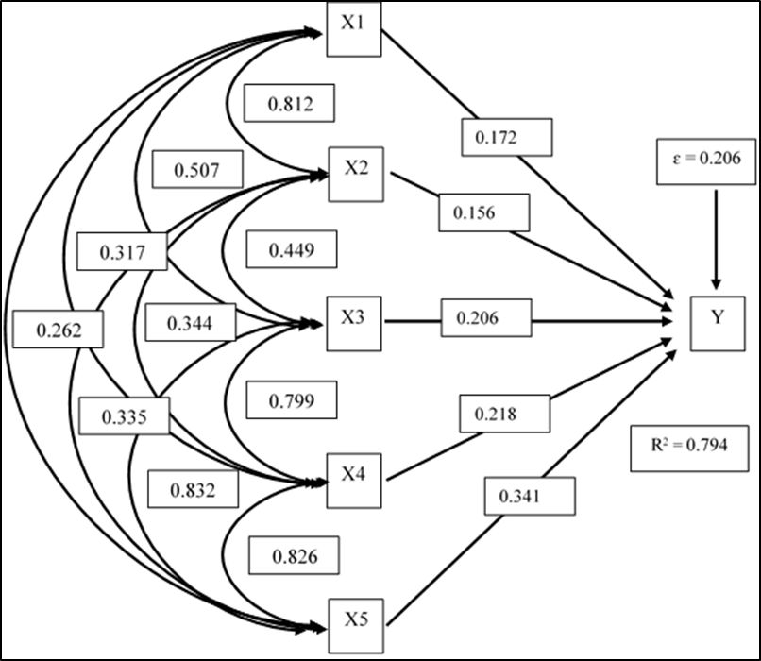

Slide 37
CONCLUSION
variables competition among similar companies partially significant effect on competitive advantage to the SMEs in the Department of Cooperatives and SME South Tangerang City. This is evidenced by the results of the calculation of the value of 2,110 t> t table 1.980 and significance level of <0.05 is 0.037.
variables the entry of new competitors is partially significant effect on competitive advantage to the SMEs in the Department of Cooperatives and SME South Tangerang City. This is evidenced by the results of the calculation of the value of 2,094 t> t table 1.980 and significance level of <0.05 is 0.038.
variables the potential for product development partially significant effect on competitive advantage to the SMEs in the Department of Cooperatives and SME South Tangerang City. This is evidenced by the results of the calculation of the value of 2,159 t> t table 1.980 and significance level of <0.05 is 0.033.

Slide 38
4. variable bargaining power seller / supplier partially significant effect on competitive advantage to the SMEs in the Department of Cooperatives and SME South Tangerang City. This is evidenced by the results of the calculation of the value of 2,755 t> t table 1.980 and significance level of <0.05 is 0.007.
5. Variables bargaining power of buyers / consumers is partially significant effect on competitive advantage to the SMEs in the Department of Cooperatives and SME South Tangerang City. This is evidenced by the results of the calculation of the value of 3,701 t> t table 1.980 and significance level of <0.05 is 0.000.
6. variable competition among peers, the entry of new competitors, potential product development, and the bargaining power sellers / suppliers, and the bargaining power buyers / consumers simultaneously influence the dependent variable (Y) which is a competitive advantage. These results were confirmed by the value of F obtained at 92 011> Ftable 2:29.

Slide 39
Suggestion
South Tangerang Cooperative Agency should pay more attention to the factors that may affect the forte of competitive SMEs, in order to achieve the vision of the institution's mission Cooperative Agency aspired. Policies that favor a positive for the development of SMEs is important to do, in order to increase performance.
Department of Cooperatives of South Tangerang is expected to continue to increase training and outreach to employers to improve the quality of human resources and quality of products being traded unhtuk more creative and innovative, like customize products according to current market tastes, as well as compete with the use of more modern technology both in processing and marketing through online media.

Slide 40
Thank you

