Slide 1
Research on the Attitudes of Muhammadiyah Members towards Fatwa Majlis Tarjih and Tajdid Muhammadiyah Central Leaders. Case Study: Cigarette Haram Fatwa
Halal Conference - February 19th 2020
By: Diyah Hesti K., Nur'aini, Roosita M.D., Adi Musharianto, Sarli Amri T.P., Mukhaer Pakanna
Presenter : Diyah Hesti K.
Institut Teknologi dan Bisnis Ahmad Dahlan, Jakarta

Slide 2
Introduction
Review of Fatwa forbidden cigarette from the Tarjih Assembly and Tajdid PP Muhammadiyah 2010 number 6 / SM / MTT / III / 2010
An important message regarding the prohibition of cigarettes is
The law is obliged to strive for the maintenance and improvement of the highest degree of public health and create an environment conducive to the realization of a healthy living condition that is the right of every person and is part of the goals of sharia (maqashid syariah)
Smoking is illegal.
Those who have not or do not smoke must avoid themselves and their families from smoking experiments
Those who have already become smokers are required to make an effort and try according to their ability to quit smoking

Slide 3
This fatwa is applied keeping in mind the principles of at-tadrij (gradually), at-taisir (convenience), and ‘adam al-haraj (not to complicate).
To the Muhammadiyah Association, it is recommended that they actively participate in tobacco control efforts as part of efforts to maintain and improve the optimal degree of public health and within the framework of amar makruf nahi munkar.
All functionaries of the Muhammadiyah Persyarikatan management at all levels should be role models in an effort to create a society free from the dangers of smoking.
The government is expected to ratify the Framework Convention on Tobacco Control (FCTC)

Slide 4
Research
This research was conducted to find out how much Muhammadiyah's support for tobacco control is measured by a statement of attitude regarding the following matters:
1.1. Attitudes towards cigarette consumption of Muhammadiyah members.
1.2. Tarjih Council fatwa policy on the prohibition of smoking.
1.3. Opinion if the Tarjih Council fatwa on the prohibition of smoking is being regulated (tanfidz).
1.4. Opinion if the price of cigarettes is raised.
1.5. Opinion if the price of cigarettes is raised to Rp 50,000.

Slide 5
1.6. Opinion if every cigarette purchase is at least 18 years old with an obligation to show identity.
1.7. Opinion if the No Smoking Area (KTR) is applied in all Muhammadiyah charitable businesses.
1.8. Opinion if the Prohibition of Advertising, Promotion and Sponsorship is applied in all Muhammadiyah business charities.
1.9. Opinion if the material danger of smoking into the curriculum of Al Islam and Kemuhammadiyahan.
1.10. Opinion if the committee takes a firm stand in participants who smoke

Slide 6
Research methods
Research Theme: Muhammadiyah's attitude towards tobacco control after the issuance of an illicit fatwa on cigarettes by Majlis Tarjih & Tajdid Muhammadiyah
Time: Ramadan Recitation 1440 H, May 12, 2019 took place at ITB Ahmad Dahlan Jakarta
Research Methods: Descriptive research to find out how smoking behavior of Muhammadiyah residents and support for tobacco control such as rising cigarette prices, limiting the circulation of cigarettes, KTR and smoking bans on Muhammadiyah events

Slide 7
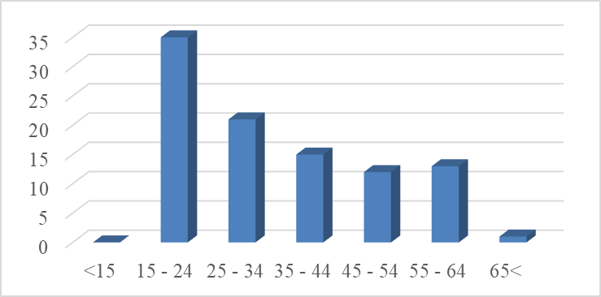
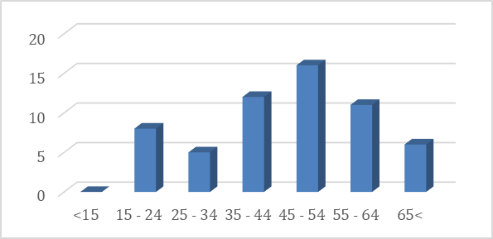
Sample Composition
A sample of 177 people were randomly drawn from a total of 750 participants.
75% Men, 25% Women of varied ages
Male Female
12 % from sample are smoker

Slide 8
Tarjih Council Fatwa Policy on the Haram of Smoking
85% of the sample agreed to the cigarette haram fatwa

Slide 9
Fatwa Majelis Tarjih on the Haram of Smoking Done
Tanfidz, which can be interpreted as the implementation phase, needs to be done to become a provision that must be carried out properly and as a guide and reference
83% of Muhammadiyah recitation study respondents agreed tanfidz about the prohibition of smoking

Slide 10
Application of FCTC
Cigarette haram fatwa has the message of implementing FCTC or Framework Convention on Tobacco Control (FCTC) to strengthen the foundation for tobacco control efforts in the context of optimal public health development. FCTC policies include:
Cigarette Price Increase to control cigarette consumption
Prohibit cigarette advertisements
Application of KTR
Ramadan study respondents were asked their opinions regarding the application of this FCTC policy in Muhammadiyah and the results were as follows:

Slide 11
Cigarette Prices
Cigarette Prices Raised: 77% of respondents agreed
Cigarette prices raised to Rp 50,000: 69% agree

Slide 12
Minimum Age Restrictions 18 years
The government's target to reduce the prevalence of child smoking to 5.4% was not achieved but instead increased sharply to 9.1% (Riskedas 2018). Efforts to limit the purchase of cigarettes with a minimum age limit of 18 years turned out to be supported by the majority of the sample members of Muhammadiyah. As many as 64% support the minimum age limit of 18 years.

Slide 13
The No Smoking Area (KTR) is implemented in all Muhammadiyah charitable businesses
The adoption of cigarette haram fatwas from the Tarjih and Tajdid Council of Muhammadiyah will require the No Smoking Area (KTR) to all Muhammadiyah charitable businesses. As many as 63% of the sample members of Muhammadiyah agreed to apply this KTR

Slide 14
Mandatory Ban on Advertising, Promotion and Sponsorship in Muhammadiyah Charitable Enterprises
The declaration of a cigarette product is haram and has consequences forbidding Muslims not only to use the product but also from trade in it. There is a need to ban advertising, promotion and sponsorship in all Muhammadiyah business charities. This view is supported by 60% of the sample of Muhammadiyah members.

Slide 15
Material of the danger of smoking entered into the curriculum of Al Islam and Kemuhammadiyahan
The promotion of cigarette haram fatwas needs to be included in the dangers of smoking in the curriculum of Al Islam and Kemuhammadiyahan (AIKA). As many as 59% of the sample members of Muhammadiyah agreed with the cigarette illicit fatwa taught in the AIKA curriculum.

Slide 16
The Committee Firmly In Prohibiting Smoking Participants
Ramadan recitation activities that are routinely organized by Muhammadiyah are expected to be more assertive in banning smoking participants. Smoking is harmful to oneself and others who are exposed to cigarette smoke because cigarettes are addictive and dangerous substances as agreed upon by medical experts and academics and therefore smoking is against Islamic principles.

Slide 17
Policy Recommendations
After 10 years of smoking forbidden fatwa was issued by Muhammadiyah, many people already know the dangers of smoking, including information on the pack of cigarettes themselves (except for electronic cigarettes, there are still no packs with warnings about smoking). With this assumption, it is appropriate for the application of smoking haram fatwa at the stage of total prohibition through the Muhammadiyah tanfidz decision.
Case studies on the adoption of smoking haram fatwas in Saudi Arabia can be a lesson for Muhammadiyah. Saudi Arabia's health minister and NGOs work together to run education programs in schools and for adults, monitor policy implementation, run smoking cessation clinics and take part in FCTC.

Slide 18
MTCC UMY also offered the concept of "Friends Comfortable Camp" for the implementation of the No Smoking Area which could become a guideline for all Muhammadiyah charities. Other initiatives also carried out by Muhammadiyah Tobacco Control for the integrity pact of the Muhammadiyah business charity administrator are non-smokers.
That's all THANK YOU

