Slide 1
Effect of intellectual capital, audit quality, and leverage of earnings management (empirical study on transportation companies in indonesia)
by:
NAWANG KALBUANA│NITA YULISTIANI│FIQI RAHMAWATI

Slide 2
Table of contents
On Cases
Research Background
Problem Formulations
Research Framework & Hypotheses
Data Collection & Selection
Operational Variables
Results of Statistical Description Analysis
Results of Classical Assumption Test
Results of Hypothesis Test
Conclusions
Limitations of Research & Suggestions

Slide 3
On cases
Two of president commissioners of PT Garuda Indonesia Tbk refused to sign the financial statement of 2018 because they disapproved with revenue recognition of $239.9 M US from Mahata Agreement.
PT Bank Lippo Tbk recognized their assets of Rp 22.8 T, net losses of Rp 1.2 T, and CAR of 4.2% in the financial statement for the 3rd quarter of 2002 to the Jakarta Stock Exchange (JSX). The numbers were differed from their previous financial statement that had been published a month ago.

Slide 4
Research background
The financial statement is interpreted as an output that was generated by management which contains information related to the balance sheet and the performance of company in particular period.
It is not uncommon for management to adjust financial report for specific purposes. The most frequent method used by management is to manipulate the company's earnings in the current year, or to make an earning stock in the following year.
To produce quality, relevant, and actual financial reports, a qualified and authorized auditor is needed.
To determine whether the company is managing its finances correctly one of them by looking at the level of leverage in the statement of financial position.
Intellectual capital is a concept that divides into three different categories, namely human capital, structural capital, and customer capital which add a valuable value to the company (Yudhanti & Shanti, 2011).

Slide 5
Problem formulations
Is there any effect of intellectual capital, audit quality, and leverage toward earnings management?
Is there any effect of intellectual capital partially toward earnings management?
Is there any effect of partial audit quality toward earnings management?
Is there any effect of leverage partially toward earnings management?

Slide 6
RESEARCH FRAMEWORK
HYPOTESES
Intellectual Capital (X₁)
H₂
H₁: | Intellectual capital, audit quality, and leverage simultaneously have an effect on earnings management.
H₂: | Intellectual capital has an effect toward earning management.
H₃: | Audit quality has an effect toward earning management.
H₄: | Leverage has an effect toward earning management.
H₃
Audit Quality (X₂)
Earnings Management (Y)
H₄
H₁
Leverage (X₃)

Slide 7
DATA collection & selection
Definitions | Number of Companies | The Amount of Data
Transportation companies listed on Indonesia Stock Exchange in 2014-2018 | 45 | 171
Transportations companies that have not consistently published financial statements ended in 2014-2018 | (15) | (22)
Transportation companies that issued financial statements in currencies other than rupiah in 2014-2018 | (15) | (74)
Transportation companies that do not have employee expenses on the 2014-2018 financial statements | (1) | (5)
Data issued after the outlier test |  | (2)
Total research samples during 2014 - 2018 | 14 | 68
The financial statements are used as samples for the period 2014 – 2018 that retrieved from idnfinancials.com. The study population consists of 45 transportation companies using purposive sampling method.

Slide 8
Operational variables
Intellectual Capital
(Pulic Model/VAIC™)
Audit Quality
(1 for Big 4, 0 for Non Big 4)
Leverage
(Total Debt/Total Asset)
Earnings Management
(Modified Jones Model)

Slide 9
Results of Statistical Description Analysis
Variable | N | Min | Max | Mean | Std. Dev
DA | 68 | 0,00 | 0,31 | 0,0361 | 0,0616
IC | 68 | 0,00 | 10,56 | 2,2717 | 2,0448
AQ | 68 | 0,00 | 1,00 | 0,1618 | 0,3710
LVR | 68 | 0,01 | 8,31 | 1,1077 | 1,8195

Slide 10
Results of Classical Assumption Test
NORMALITY TEST │MULTICOLLINEARITY TEST
│autocorrelation test │heteroscedasticity test

Slide 11
NORMALITY TEST
Asymp. Sig (2-tailed) before the transformation | 0,000
Asymp. Sig (2-tailed) after the transformation | 0,200
The value of earnings management variable was transformed into log to get over the normality problem. The score after transformation is 0,200, higher than the signification score of 0,05. It indicates that the regression model had normal distribution.

Slide 12
MULTICOLLINEARITY TEST
Variable | Tolerance* | VIF** | Definition
IC | 0,993 | 1,007 | There is no multicollinearity
AQ | 0,987 | 1,013 | There is no multicollinearity
LVR | 0,990 | 1,010 | There is no multicollinearity
*Tolerance > 0,1
**VIF < 10

Slide 13
AUTOCORRELATION TEST
Durbin-Watson | dL | dU
1,607 | 1,516 | 1,700
dL < d < 4-dU
The regression model does not occur autocorrelation and is well used in research.

Slide 14
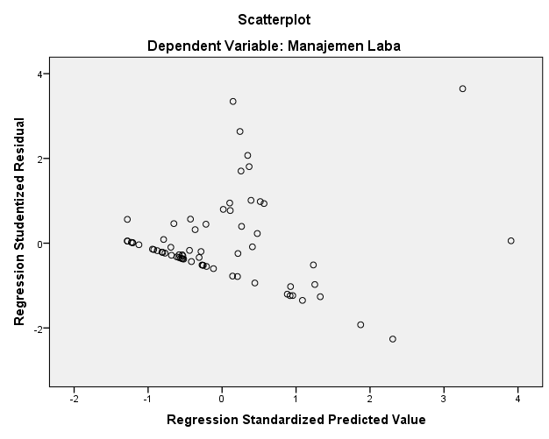
HETEROSCEDASTICITY TEST
It appears that the points in the scatterplot graph are spread between the x and y axes. This shows that heteroscedasticity symptoms do not occur so that the regression model is good for use in research.

Slide 15
Results of Hypothesis Test
COEFFICIENT OF DETERMINATION│STATISTICAL TEST F (SIMULTANEOUS TEST)│STATISTICAL TEST T (PARTIAL TEST)

Slide 16
COEFFICIENT DETERMINATION
R | R² | Adjusted R²
0,493 | 0,243 | 0,207
It can be seen the value of the coefficient of determination (adjusted R2) of 0.207. This shows that the variables of intellectual capital, audit quality, and leverage have an effect of 20.7% on earnings management. Other variables that affect earning management that were not covered in this study is 79.3%.

Slide 17
Statistical test f
F Count | 6,836
Sig. | 0,000
The F count is 6.836 and the significance value is 0.000. The calculated F value is greater than the F table obtained which is 2.75. So it can be concluded that the variables of intellectual capital, audit quality, and leverage simultaneously affect earnings management. Thus H₁ is accepted.

Slide 18
Statistical test t
DA = -0,003 + 0,010 IC + 0,024 AQ + 0,012 LVR + ε
Variabel | B | t* | Sig | Keterangan**
DA | -0,003 | -0,254 | 0,801
IC | 0,010 | 2,900 | 0,005 | Take effect
AQ | 0,024 | 1,319 | 0,192 | No effect
LVR | 0,012 | 3,368 | 0,001 | Take effect
*t table is 1,669
** H₂ & H₄ were accepted, H₃ was rejected

Slide 19
conclutions
From this research, it can be concluded that the variables of intellectual capital, audit quality, and leverage simultaneously influence earnings management in transportation companies.
The effect of intellectual capital and leverage variable toward earning management was confirmed. While the variable of institutional ownership and managerial ownership proved to have no effect on earnings management. Consequently, only H1, H2 and H4 are accepted.

Slide 20
Limitations of research & suggestions
The companies studied were only 14 transportation companies with a total sample of 68 from idnfinancials.com. Suggestions for future research can be use or add similar company sectors such as infrastructure and utilities. Further research can also be carried out on state-owned companies.
Selection of variables that are still common. For further research can use other financial ratio variables such as the ratio of return on assets (ROA), return on equity (ROE), free cash flow, and debt to equity (DER).
So far there has been no research linking the effect of intellectual capital on earnings management. Most studies use the intellectual capital variable as an indicator to measure the company's financial performance. This is caused by the treatment of intellectual capital as a variable that adds value to the company. Further research is needed to examine whether intellectual capital can overcome earnings management actions at other companies on the Indonesia Stock Exchange.

Slide 21
Questions?

