Slide 1

Halal Food Supply Chain Management Research
By: Associate Professor Ferry Jie, PhD
School of Business and Law,
Edith Cowan University
Joondalup, Western Australia

Slide 2
Publications
Hosen, MN., Lathifah, F., Jie, F., (2019), Perception and expectation of customers in Islamic bank perspective. Journal of Islamic Marketing, n/a(n/a), 18, UK, DOI: https://doi.org/10.1108/JIMA-12-2018-0235.
Maman, U., Mahbubi, A., Jie, F., (2018), Halal Risk Mitigation in the Australian–Indonesian Red Meat Supply Chain. Journal of Islamic Marketing, 9(1), 60-79, Emerald.
Zulfakar, H., Chan, C., Jie, F., (2018), Institutional forces on Australian halal meat supply chain (AHMSC) operations. Journal of Islamic Marketing, 9(1), 80-98, United Kingdom, Emerald Publishing Limited, DOI: 10.1108/JIMA-01-2016-0005.
Maman, U., Mahbubi, A., Jie, F., (2017), Strategic Planning to Control Halal Risk in Indonesian Beef Supply Chain. International Business Management, 11(6), 1246-1253, Al Rega, Pakistan, Medwell Journals, DOI: 10.3923/ibm.2017.1246.1253.
Masudin, I., Fernanda, F., Jie, F., Djajadikerta, H., Widayat, ., (2018), Muslim and non-muslim perceptions on Halal Meat Logistics (HML). IOP Conference Series: Materials Science and Engineering, 403(29 November 2017 through 30 November 2017), article no.012054, Bristol, England, Institute of Physics Publishing, DOI: 10.1088/1757-899X/403/1/012054.
Wan Marhaini , WO., Rahman, S., Jie, F., (2015), Halal food chain management: a systematic review of literature and future research directions. Proceedings of the 13th ANZAM Operations, Supply Chain and Services Management Symposium (ANZAM 2015), 25p., Queensland, Australia, Australian and New Zealand Academy of Management (ANZAM).

Slide 3
Supply Chain Management Structure in general
Transportation
Transportation
Customers
Warehousing
Information
flows
Factory
Transportation
Vendors/plants/ports
Warehousing
Transportation
CR (2004) Prentice Hall, Inc.
1-2

Slide 4
Supply Chain Management Defined
CR (2004) Prentice Hall, Inc.

Slide 5
Supply Chain Integration
5
Internal Process Integration: increase collaboration among the company’s functional groups.
Backward Process Integration: collaboration with 1st-tier and 2nd-tier (leading companies) suppliers.
Forward Process Integration: collaboration with 1st-tier customers.
Complete Integration: collaboration from the “suppliers’ supplier to the customers’ customer.”

Slide 6
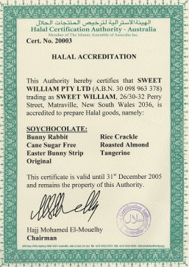
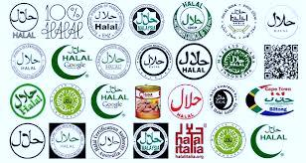
Halal Food Supply Chain
The market for Halal food is now evolving in a rapid pace
The global Muslim population is projected to have a steady increase from 1.6 billion in 2010 to 2.2 billion in 2030 (PewResearch 2011)
Definitions of Halal supply chain:
“process of planning, implementing & controlling the efficient flow and storage of Halal certified product from source to the demand point”
(Che Man et al, 2007)
“process of managing the procurement, movement, storage and handling food products through the organisation and the supply chain in compliance with the general principles of Shariah law”
(Tieman, 2009)

Slide 7
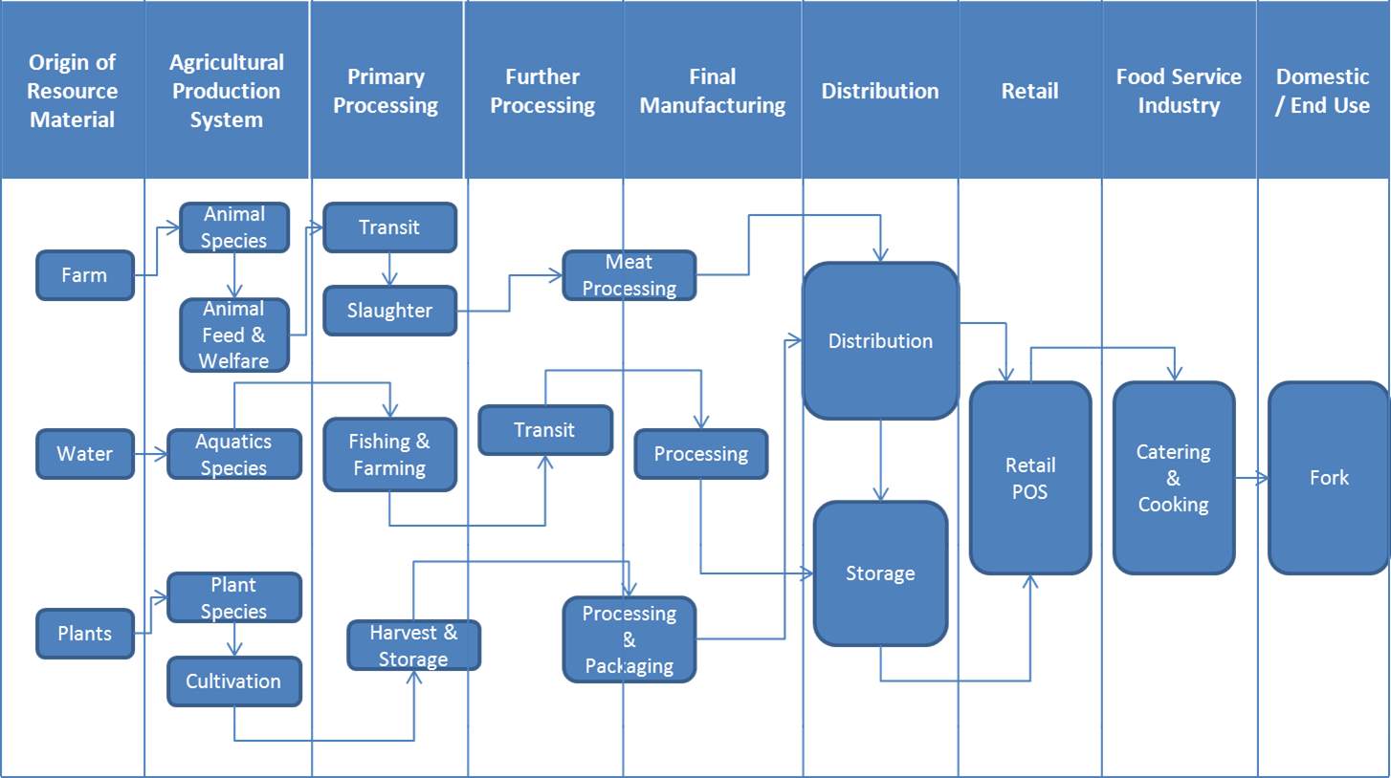
Halal Food Supply Chain (Lodhi, 2009)

Slide 8
Literature Review on Halal Food SC
Halal food supply chain (Lodhi 2009; Zulfakar, Jie & Chan 2012). Most Halal studies have examined consumer issues, issue of traceability and the tracking system, Halal certification and legal aspects, biotechnology in Halal, quality assurance, competitiveness, Halal packaging and branding (Alam & Sayuti 2011; Ireland & Rajabzadeh 2011; Norman, Nasir & Azmi 2008; Razalli, Yusoff & Roslan 2013; Zakaria 2008; Talib & Johan 2012; Al Halaseh & Sundarakani 2012; Bohari, Hin & Fuad 2013; Wilson & Liu 2010; Ceranić & Božinović 2009)

Slide 9
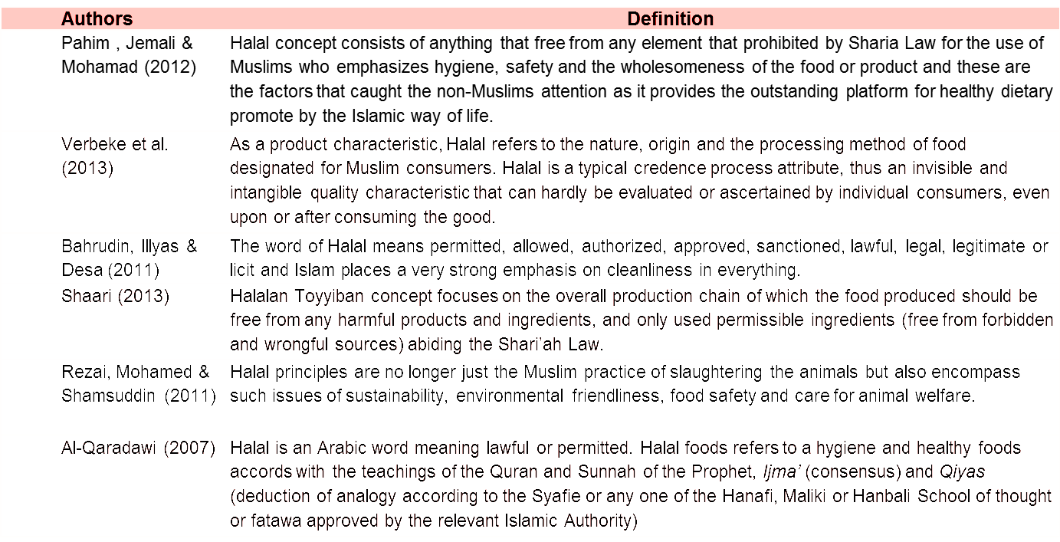
Literature Review on Halal Food SC

Slide 10
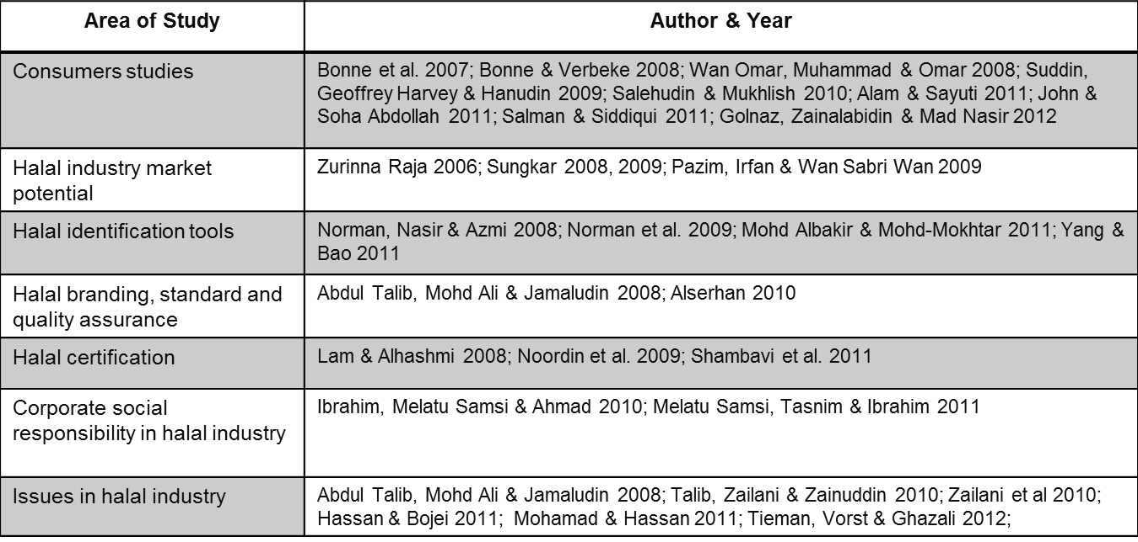
Literature Review on Halal Food SC

Slide 11
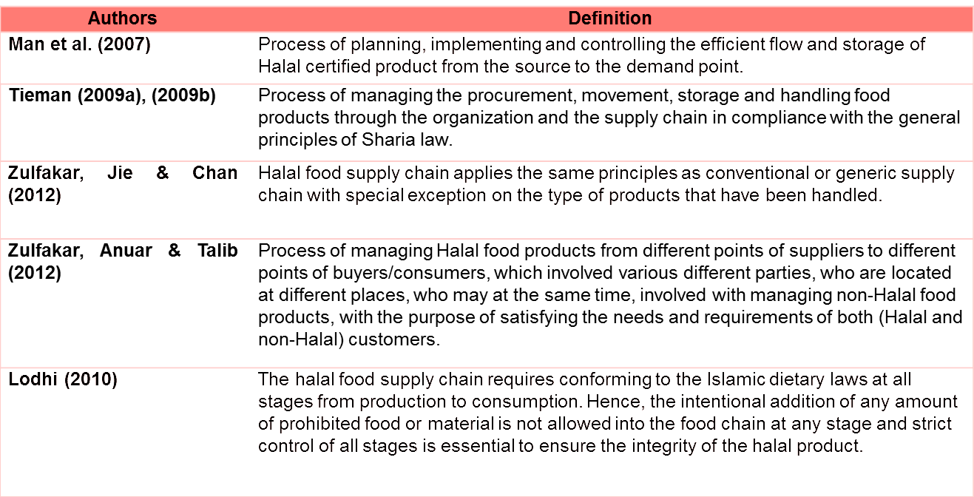
Literature Review on Halal Food SC

Slide 12
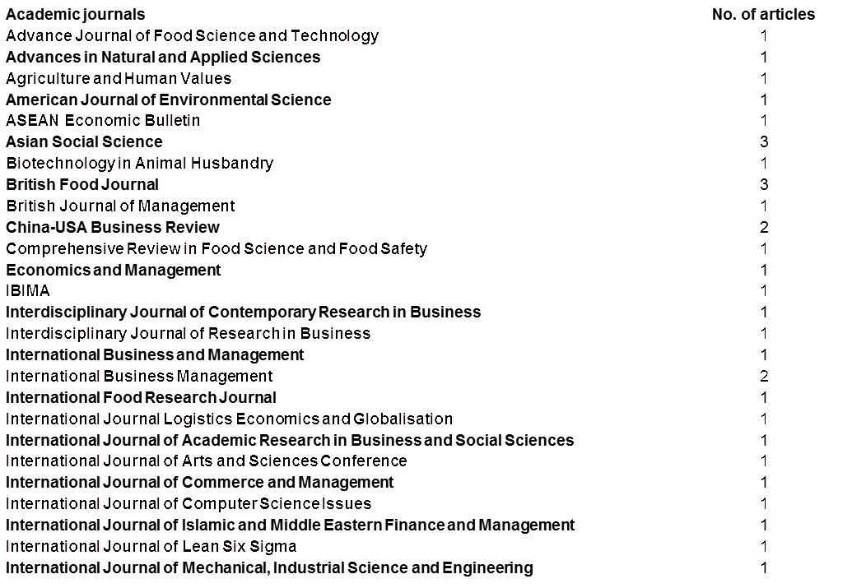
Publications lists related on Halal studies

Slide 13
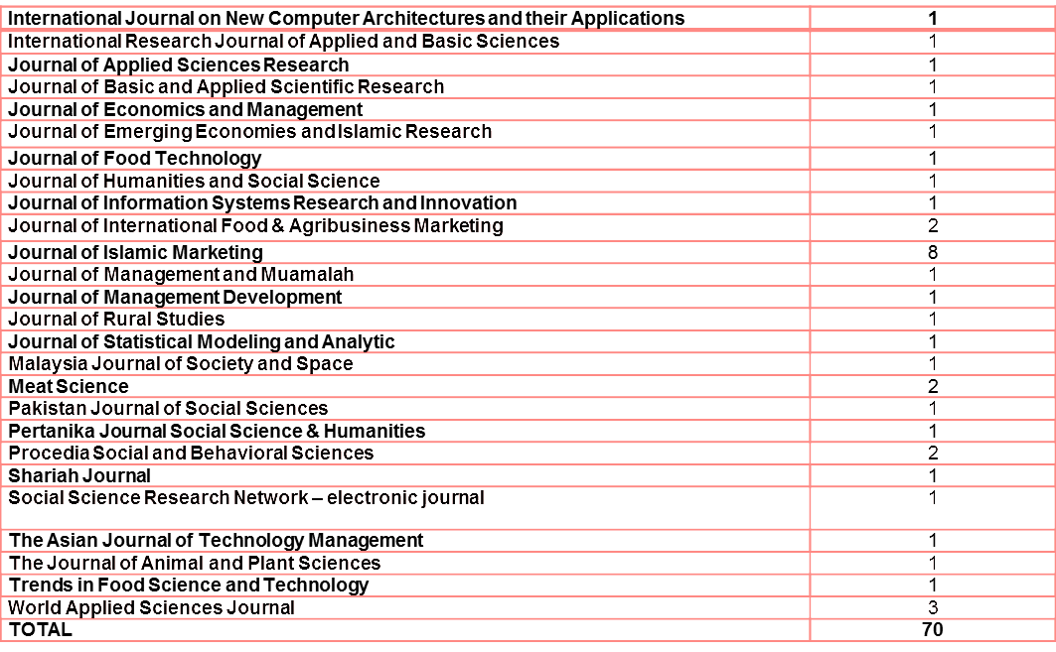
Publications lists related on Halal studies

Slide 14
Institutional forces on Australian halal meat supply chain (AHMSC) operations
Abstract
Purpose
The purpose of this paper is to investigate the role of institutional forces in shaping the operations of halal meat supply chain in Australia, one of the world’s largest producers and exporters of halal meat. This research examines how the halal meat production requirements are fulfilled and maintained throughout the supply chain in a non-Muslim-majority country.
Design/methodology/approach
The research uses a single-case study approach and uses semi-structured interviews as the primary method of data collection. It considers the perspectives of various stakeholder groups in the Australian halal meat supply chain (AHMSC). In all, 31 participants have participated in this research.

Slide 15
Findings
The findings show that institutional forces, especially which come through coercive forces, do affect and shape the overall operations of the AHMSC in particularly the way the stakeholders act within the supply chain, particularly in their role in ensuring the protection of halal status or halal integrity of the meat.
Practical implications
This paper suggests that the integrity of halal meat supply chain management operations in a non-Muslim-majority environment can be protected with heavy involvement from the relevant authorities, i.e. the federal government agency and the halal certifiers. With the implementation of specific halal meat production policy, i.e. Australian Government Authorised Halal Program, all parties dealing with the halal meat production for export purpose are obliged to fulfil the religious and food safety requirements, thus providing the necessary assurance for halal meat consumers, especially from the Muslim communities.
Originality/value
This paper is one of the first to provide insights of halal meat supply chain operations in a non-Muslim-majority environment. This paper also took in account various stakeholder groups that were involved directly with halal meat supply chain operations in Australia rather than focusing on a single stakeholder group which gives a better understanding of the whole supply chain operations.

Slide 16
Australian Red Meat Supply Chain
Australia is among the world's largest and most successful and efficient
producers of commercial livestock and a leader in the export of red meat and
livestock. The total value of Australia's off-farm beef and sheepmeat industry
is A$16 billion (source: 2011 MLA estimate).
The Australian Meat Industry:
  The fourth highest commodity export earner
  Exports about 65 percents of its production to over 100 countries around the world
  The value of the production has increased by $2.4 billion in the last five years
  provides employment to more than 50,000 employees

Slide 17
Australian Beef Supply Chain
Fully integrated supply chains which have cattle moving from feedlot/farms to processors who transform them into beef products and organise delivery into the hands of end customers.
Partially integrated supply chains have supply chain activities only from slaughtering to end customers or from producing to slaughtering.

Slide 18
Australian Beef Supply Chain Framework

Slide 19
Literature review: Red Meat Supply Chain
Factors | Authors
Logistics, manufacturing and quality system | (Australian Business Limited 2001; Bindon and Jones 2001; Sadler and Hines 2002; Hepner, Wilcock et al. 2004)
Information flow | (Palmer 1997; Australian Business Limited 2001; Yu, Yan et al. 2001)
Technology and organisation | (Palmer 1997; Australian Business Limited 2001; Yu, Yan et al. 2001)
Safety and animal welfare | (Australian Business Limited 2001)
Partnership and collaboration | (McNeil and Wilson 1997; Palmer 1997; Spekman, Kamauff Jr et al. 1998; Fearne 1999; Yu, Yan et al. 2001; Sadler and Hines 2002; Zylbersztajn and Filho 2003; MLA 2004)
Customer relationships | (McNeil and Wilson 1997; Verbeke 2000)
Feeding | (MLA 2004)
Age, sex and appearance | (West, Larue et al. 2001; MLA 2005)
Traceability | (Viaene and Verbeke 1998; MLA, AMPC et al. 2006)
Society perceptions | (Peterson, Eenoo Jr et al. 2001)

Slide 20
Future Research Opportunities
How ready are organisations for SCM 4.0 in Halal Pharmaceutical or Cosmetics Industry
Technical issues
Contextual issues
Methodology issues
Measuring the benefits and the business case for SCM 4.0
Organisational impact and HR skills
SCM 4.0 and sustainability in Halal Cosmetics and Pharmaceutical Industry
SCM 4.0 Policy and regulation in Halal Cosmetics and Pharmaceutical Industry

Slide 21
Thank you very much indeed
Any questions/comments/feedback

