Slide 1
Evaluation of Implementing Sukuk for Infrastructure Financing in Indonesia Using The Analytic Network Process
Syifa Fauziah, Nurwahidin, Nurul Huda*
International Seminar and Conference on Halal Industry 2020
ITB Ahmad Dahlan
February 18 – 19, 2020
*Corresponding Author

Slide 2
Intoduction
Research background:
Looking at the level of state competition from the availability of infrastructure, Indonesia is still lagging behind neighboring countries. Base on the 2019 Global Competitiveness Report issued by the World Economic Forum
The Indonesian government has used sukuk financing since 2013 to accelerate infrastructure development
However the issuance of sukuk for infrastructure financing is still low compared to the total value of available underlying assets
Infrastructure is an important one for the progress of the country

Slide 3
Intoduction.. (cont’d)
The potential for sukuk issuance is estimated from the availability of the underlying assets
KPPIP (2019) notes the government still needs an investment of Rp 2.860 trillion
The issuance of sukuk until 2019 only reached Rp 1.221 trillion (RI Ministry of Finance, 2019)
The Ministry of Finance recorded the amount of BMN as of December 2018, reaching Rp 5.728,49 trillion
Research problems:
7.367,49 trillion

Slide 4
Intoduction.. (cont’d)
Why the issuance of sukuk for infrastructure financing is still low ?
It’s because many problems and barriers in implementation sukuk for infrastructure financing.
So, to encourage the issuance of sukuk to finance infrastructure, evaluation is needed on the current implementation. Especially on the side of the government as a sukuk issuer and policymaker.
Research objectives:
To analyze the main problems of implementing sukuk for infrastructure financing in Indonesia on the side of the obligor
To analyze the main solutions of implementing sukuk for infrastructure financing in Indonesia on the side of the obligor
To analyze the strategies of implementing sukuk for infrastructure financing in Indonesia on the side of the obligor

Slide 5
Method
The research uses a mixed approach
Data sources used include primary data from filling out questionnaires and in-depth interviews with respondents and secondary literature review results
Respondents on this study is purposely chosen
The data analysis method uses the Analytic Network Process (ANP) to analyze priority problems, solutions, and strategies
ANP is a decision-making method developed by Thomas L. Saaty (1980). ANP method is used to solve problems that depend on the criteria contained in the research model

Slide 6
Method.. (cont’d)
Literature review
Model construction
Model validation
Questionnaire preparation
survey
Data analysis
Result validation
Result interpretation
Questionnaire test
Expert
Researcher
Figure 3.1 ANP Research Stages, modified
Source: Ascarya, 2009

Slide 7
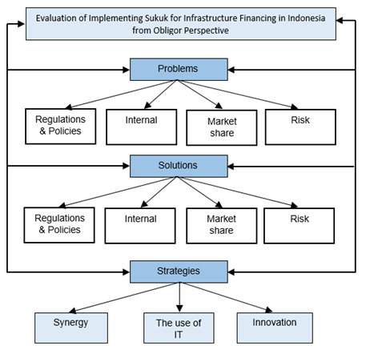
Result and Analysis
Figure 4.1 Conceptual Framework
Source: Research finding, data processed, 2019

Slide 8
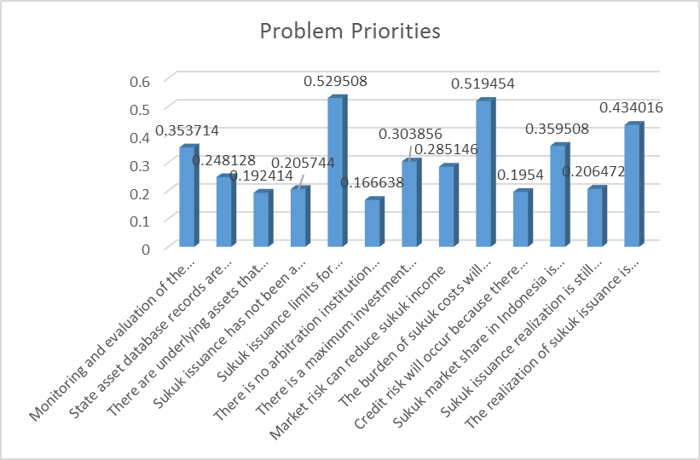
The issuance sukuk limits for infrastructure are still low with a value of 52.95%
Late construction projects that will increase the burden of sukuk costs with a value of 51,94%
with a value of 43,40% is the realization of sukuk issuance is still low compared to the value of infrastructure investment needs
The market share sukuk in Indonesia is still low compared to bonds with a value of 35,95%
Monitoring, and evaluation of the use of funds is not optimal with a value of 35,37%

Slide 9
The low limit of sukuk issuance for infrastructure is a major problem. This problem is included in the cluster of regulatory and policy issues.
Ms. Farah, a practitioner from KNKS also conveyed the following explanation;
"In 2018, project-based sukuk will reach Rp 28 trillion, then the following year the amount will decrease. We had a discussion and asked why the issuance of sukuk dropped and the answer was because the number of projects ready also declined. So the readiness of the project affects the amount of issuance of sukuk, not limited.“
Based on the theory, one of which must be considered in the issuance of sukuk is a definite underlying asset (Mutum et al., 2016). If the project itself becomes underlying, the project should be ready.

Slide 10
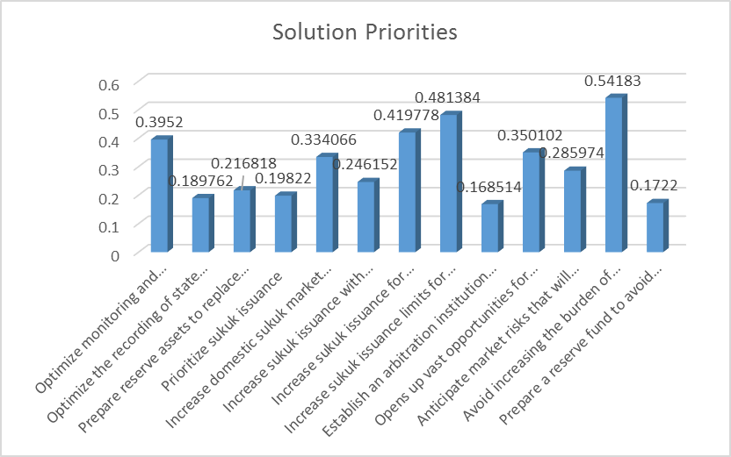
To push for the completion of sukuk-funded projects on time so as not to increase the burden of sukuk costs. The solution gets a value of 54,18%
Increase the maximum limit of sukuk issuance for infrastructure financing with a value of 48,13%
Increase sukuk issuance to meet infrastructure investment needs with a value of 41,98%
Optimize monitoring and evaluation of the use of funds with a value of 39,52%
with a value of 35,01% is opens up vast opportunities for foreign investors

Slide 11
Late project completion can result in increased cost burdens. It'is a risk for the government as an obligor.
Although Hadiningdyah (2019) explained that there had been many ways taken to monitor and evaluate ministries and institutions in completing projects.
"... there is an evaluation forum. The evaluation forum is to bring together ministries and institutions whose performance is still low. We also invite those with excellent performance to give testimonials and sharing sessions. Then we also hold a high-level meeting. At the High-level meeting, we invited the heads of ministries and agencies to inform about sukuk financing and how the financing process is. “
So far, the government has indeed carried out monitoring and evaluation. There are still projects that are overdue and not even completed until the end of the contract period.

Slide 12
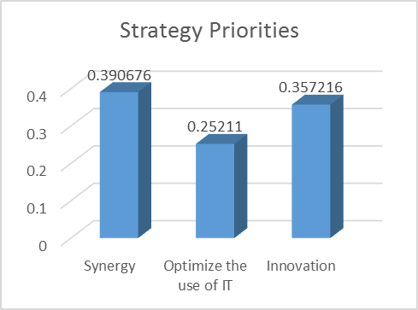
The first strategic priority is a synergy to obtain results in the amount of 39.07%. The second priority is an innovation that is equal to 35.72%. Then, the optimization of IT usage is 25.21%.

Slide 13
Conclusion
There are four problem clusters and solutions faced by obligors in implementing state sukuk for infrastructure financing in Indonesia:
Internal
Market share
Regulations and policies
Risks
The first priority was the limit of sukuk issuance which was still low. Second, the burden of increased costs due to late completion of the project. Third, the realization of sukuk issuance for infrastructure is still low compared to the value of infrastructure investment needs. Fourth, market share sukuk in Indonesia is still low compared to bonds. The fifth is monitoring and evaluation of the use of funds is not optimal.
The solution priority is the first to encourage project completion on time so as not to increase the burden of sukuk costs,. Second, to increase the maximum limit for the issuance of sukuk for infrastructure financing. Third, increase sukuk issuance to meet infrastructure investment needs. Fourth, Optimize monitoring and evaluation of the use of funds. Fifth, to open up opportunities for foreign investors. The priority strategies that can be implemented are synergy, innovation, and optimizing the use of IT.

Slide 14
Acknowledgement
We would thank to Universitas Indonesia for funding this research
Author
Syifa Fauziah, S.Ag, is master’s student at School of Strategic and Global Studies, University of Indonesia, Jakarta
Dr. Drs. Nurwahudin, M.Ag, is currently has a lecturing positions at School of Strategic and Global Studies, University of Indonesia
Prof. Dr. Nurul Huda, SE., MM., M.Si, is The Head of Magister Management Programe in YARSI University

