Slide 1
FUZZY DEMATEL APPROACH IN DETERMINING HALAL WARRANTY STANDARDS FACTORS

Slide 2
INTRODUCTION
Halal is a right for Muslims and consuming it is an order from Allah SWT, in the Qur'an (QS. Al-Baqarah 168). Indonesia is the largest Muslim country in the world, in 2019 Muslims reached 87% of the total population of Indonesia (https://databoks.katadata.co.id/).According to page halalmui.org in 2019 the proportion of halal certificates issued through the Indonesian Ulama Council (MUI) with products circulating in the market is 6.89%, seen in table 1 below;
Source : http://www.halalmui.org/

Slide 3
INTRODUCTION
The obstacle for the abattoir industry (RPH) industry does not yet have halal certification, one of the factors is the lack of knowledge about the requirements to get halal certification. The certification procedure requires eleven requirements and involves the Halal Product Guarantee Agency (BPJHP) as the regulator, the Halal Examining Agency (LPH) as the auditor and the MUI as the fatwa giver. Halal certification provides assurance that the raw materials for products, preparation, processing, hygiene and sanitation procedures meet not only halal standards but also meet good supply chains (http://www.halalmui.org).

Slide 4
INTRODUCTION
In this observe the use of the Fuzzy Dematel approach in finding a solution about problems that are interrelated with the basic concepts to measure the level of influence of an object with other objects (Dytczak & Ginda , 2013). The basic description of contextual relations and the power of influence between parts of the models within the form of causal diagrams using directed graphs and to answer the core problems of advanced systems in resolution making is a function of Fuzzy Dematel (Wu, 2008). The utilization of the Fuzzy Dematel approach, the computational process is carried out in the Matlab programming language. This research activity aims to produce outcomes with achievements to help BPJHP, LPH and MUI in making decisions

Slide 5
LITERATURE REVIEW
MUI Halal Certificate is a written fatwa of the Indonesian Ulama Council which states the halal standing of a product according to Islamic sharia. The aim of the MUI Halal Certification in meals merchandise, drugs, cosmetics and different merchandise is to offer simple task of halal standing, to be able to reassure costumers in consuming them. The continuity of the halal manufacturing procedure is assured trough manufacturers through enforcing the Halal Insurance System (https://disnakerin.padang.go.id/).
The benefit of the dematel fuzzy method are;
(1). Provide a systematic approach to identifying the relationship between the criteria, criteria and weight of each for the basis of decision making (Varma & Kumar, 2012)
(2). The type of the causal diagram supplies an output within the type of directed grap, it provides a fundamental classification of the strength of influence between elements and contextual relations (Wu, 2008)
(3). The ability to answer high complexity systems and address core problems within the determination making process (Hu, et., All 2011)

Slide 6
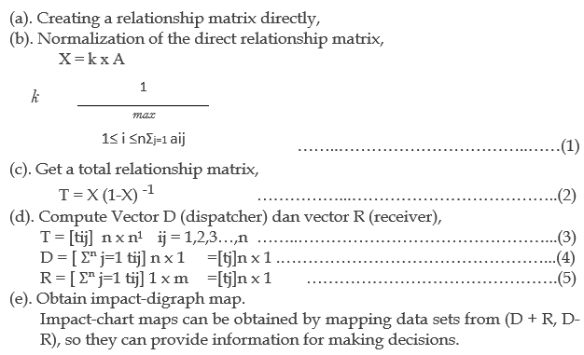
LITERATURE REVIEW
A comprehensive method for designing and analyzing the model structure of the existence of a causal relationship between several factors is the advantage of Damatel (Lin, et., All 2011) The five stages possessed by the Dematel Method (Wu, 2008) namely;

Slide 7
LITERATURE REVIEW
Matlab is the Matrix Laboratory because that every data in Matlab uses a matrix basis. Matlab is incorporated within the category of top degree programming language, case delicate, and closed in a numerical computing environment developed by MathWorks. The ability to make graphics with the best visualization. Having lots of tools that can help various disciplines and having lots of libraries that are very helpful for fixing mathematical issues comparable to making mathematical modeling, designing GUIs and simulating functions are the most popular advantages possessed by Matlab. This has become one of the industrial factors using Matlab.

Slide 8
METHOD
The approach in this research is quantitative, a case study conducted at the Abattoir in South Tangerang through the use of the fuzzy dematel approach in determining the eleven requirements of the halal guarantee system criteria. The reason why the chosen RPH object within the South Tangerang space is as a result of The Institute of Technology and Business Ahmad Dahlan is within the South Tangerang area with the hope that the ITB-AD campus could have a positive impact on the surrounding community. To collect data, the opinions of experts who have more than 10 years experience working in the abattoir.
In the usage of the Fuzzy Dematel approach, the computational process is carried out in the Matlab programming language. According to the reason, this analysis objectives to create a approach to analyze the obstacles confronted through RPH industry in the halal certification process. This research activity is planned with the achievement of producing an outcome to assist the BPJHP, LPH and MUI in making decisions.

Slide 9
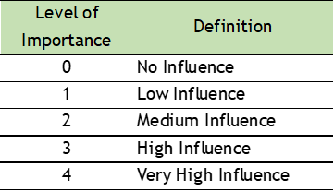
METHOD
The success of Dematel has been implemented in various fields of research in the process of simplifying problems of high complexity and structured transformation in causal relationships (Lin, et.all., 2011).
Below this is the scale used in Fuzzy Dematel;

Slide 10
METHOD
HAS 23000:1 Criteria Of Halal Warranty System / SJH

Slide 11
METHOD
HAS 23000:1 Criteria Of Halal Warranty System / SJH
Source : http://www.halalmui.org/

Slide 12
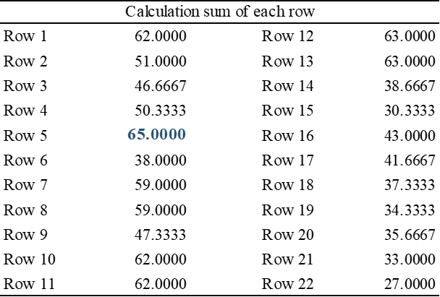
FUZZY DEMATEL APPROACH
Step 1. Calculation of K

Slide 13
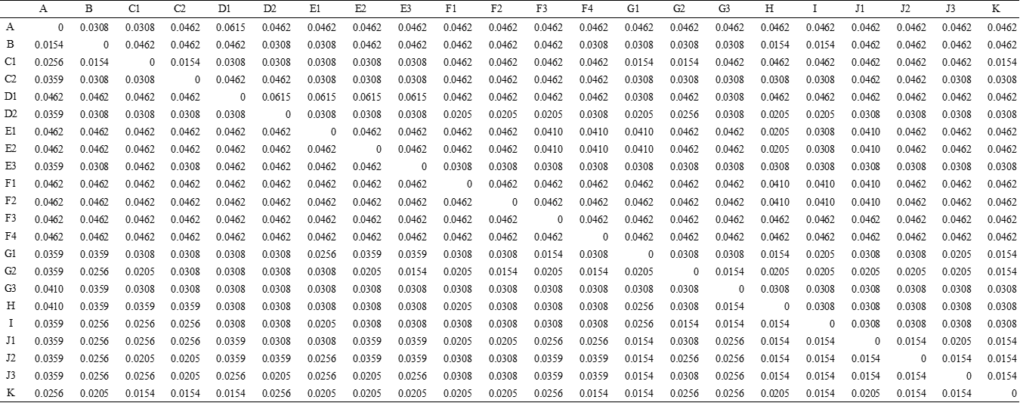
FUZZY DEMATEL APPROACH
Step 2. Calculation of S
S = K x T
Table S

Slide 14
FUZZY DEMATEL APPROACH
Step 3. Calculation of M
M = X (I – X) ˉ ¹
Table M

Slide 15
FUZZY DEMATEL APPROACH
Step 4. Calculation of M
M = Mij I,J = 1,2,…, N
Step 5 and 6)
Calculation of R + D and R – D
Table Row + Column and Row - Column

Slide 16
FUZZY DEMATEL APPROACH
Step 7) Drawing lead to and impact diagram with appreciate to the coordinates obtained within the previous step After calculating the general step, the next diagram is obtained. It represents the have an effect on and effectiveness of indices (necessary indices in SJH selection) is in a two-dimensional space.

Slide 17
DISCUSSION
The results obtained through of fuzzy DEMATEL analysis provides insight into SJH. The significance order of the barriers is obtained as D1, A, F3, F4, F2, F1, E2, E1, E3, C2, B, C1, D2, G3, J2, J1, J3, H, G1, I, G2, K, based on the R + C value. Further, these barriers have been classified into two groups using values of R - C dataset. The positive value of R - C shows the influential.
CONCLUSION
Halal certification turn into a product obligation, in the process of obtaining halal certification there are several obstacles faced by businesses. In this examine the result of R-C are eleven causes which influence the other criteria. While the effect there are a number of eleven criteria that receive influence from other criteria. In determining the resulting criteria, the entrepreneur must prioritize the cause criteria, because the value is greater than the effect.

Slide 18
Thanks You!

