Slide 1
The Capitalization of Politics Identityin Halal Products; Fashion and Cosmetics Industry
Yulianti Muthmainnah, Institut Teknologi dan Bisnis Ahmda Dahlan Jakarta
Ilham Mundzir, University of Prof. Dr. HAMKA (UHAMKA) Jakarta

Slide 2
Contents
1
Abstrak dan Dasar Pemikiran
2
Sejarah Jilbab di Indonesia
3
Doktrininasi Jilbab Melalui Iklan?
4
Politik Identitas dan Produk Halal
5
Catatan Akhir, Sebuah Kesimpulan

Slide 3
Abstract
Isu produk halal merupakan fenomena industri yang dekat dengan politik identitas, karena produk halal menjanjikan standar jaminan atas ketaatan konsumen pada norma-norma agama terutama terkait kebutuhan sehari-hari yang dikonsumsi. Jilbab dan kosmetika halal merupakan dua contoh produk yang sangat dekat dengan politik identitas dan seolah-olah menggaransi kebutuhan konsumen atas produk halal. Beragam materi iklan maupun informasi tentang konten halal dalam sebuah produk merupakan jawaban atas kebutuhan konsumen terkait dua produk halal yang kebanyakan dikonsumsi oleh perempuan (muslimah). Penelitian ini berupaya menjelaskan pandangan, persepsi, dan respon atas produk fashion dan kosmetika dengan jaminan produk halal yang diperoleh dari questioner, analisis iklan produk halal, dan kajian pustaka terkait materi produk halal tersebut.

Slide 4
The issue of halal products is an industrial phenomenon that closely to identity politics, because halal products promise guaranteed standards of consumer adherence to religious norms, especially related to daily needs consumed. Hijab and halal cosmetics are two examples of products that are very close to identity politics and as if guaranteeing consumer needs for halal products. Various advertising materials and information about halal content in a product is an answer to the needs of consumers related to the two halal products which are mostly consumed by women (Muslim). This study seeks to explain the views, perceptions, and responses of fashion and cosmetics products with the guarantee of halal products obtained from questioners, analysis of halal product advertisements, and literature review related to the halal product material.
The issue of halal products is an industrial phenomenon that is close to identity politics, because halal products promise guaranteed standards of consumer adherence to religious norms, especially related to daily needs consumed. Hijab and halal cosmetics are two examples of products that are very close to identity politics and as if guaranteeing consumer needs for halal products. Various advertising materials and information about halal content in a product is an answer to the needs of consumers related to the two halal products which are mostly consumed by women (Muslim). This study seeks to explain the views, perceptions, and responses of fashion and cosmetics products with the guarantee of halal products obtained from questioners, analysis of halal product advertisements, and literature review related to the halal product material.

Slide 5
Hijab in Europe;
Islamic Street Wear
Cartoon of Prophet Muhammad (Danish Cartoons)
resistance and increasing of politic identity
Asmahan Mansour and FIFA
NIKE
GDP 6,7 billion dollar
Muslim Countries

Slide 6
Story of Wearing Veil in Indonesia
1. Just cover head, hair, some of hair and neck can be look
Before 1945
4. Advertisement
regulation, and politic identity
Hijab
Doctrination
New Ordo
2. Prohibition wearing veil
SK No. 052/C/Kep/D.8, debatable of miss universe and swimsuit
5. Religious fundamentalist
Politic
identity
3. Regional autonomy; 421 regulation, (333 for woman)
Dichotomy; syar’I and jilboobs
Reformasi

Slide 7
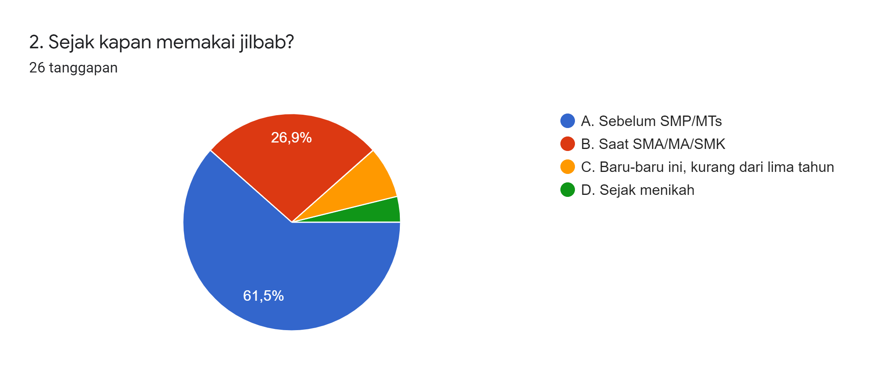
The first time wearing veil

Slide 8
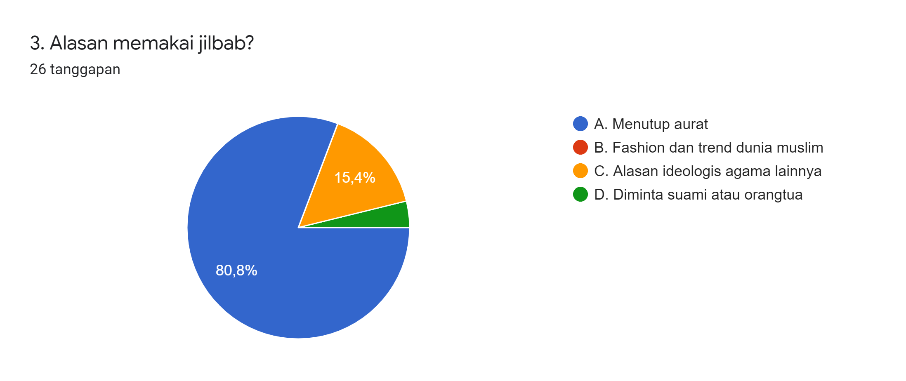
Basic argument of wearing veil

Slide 9
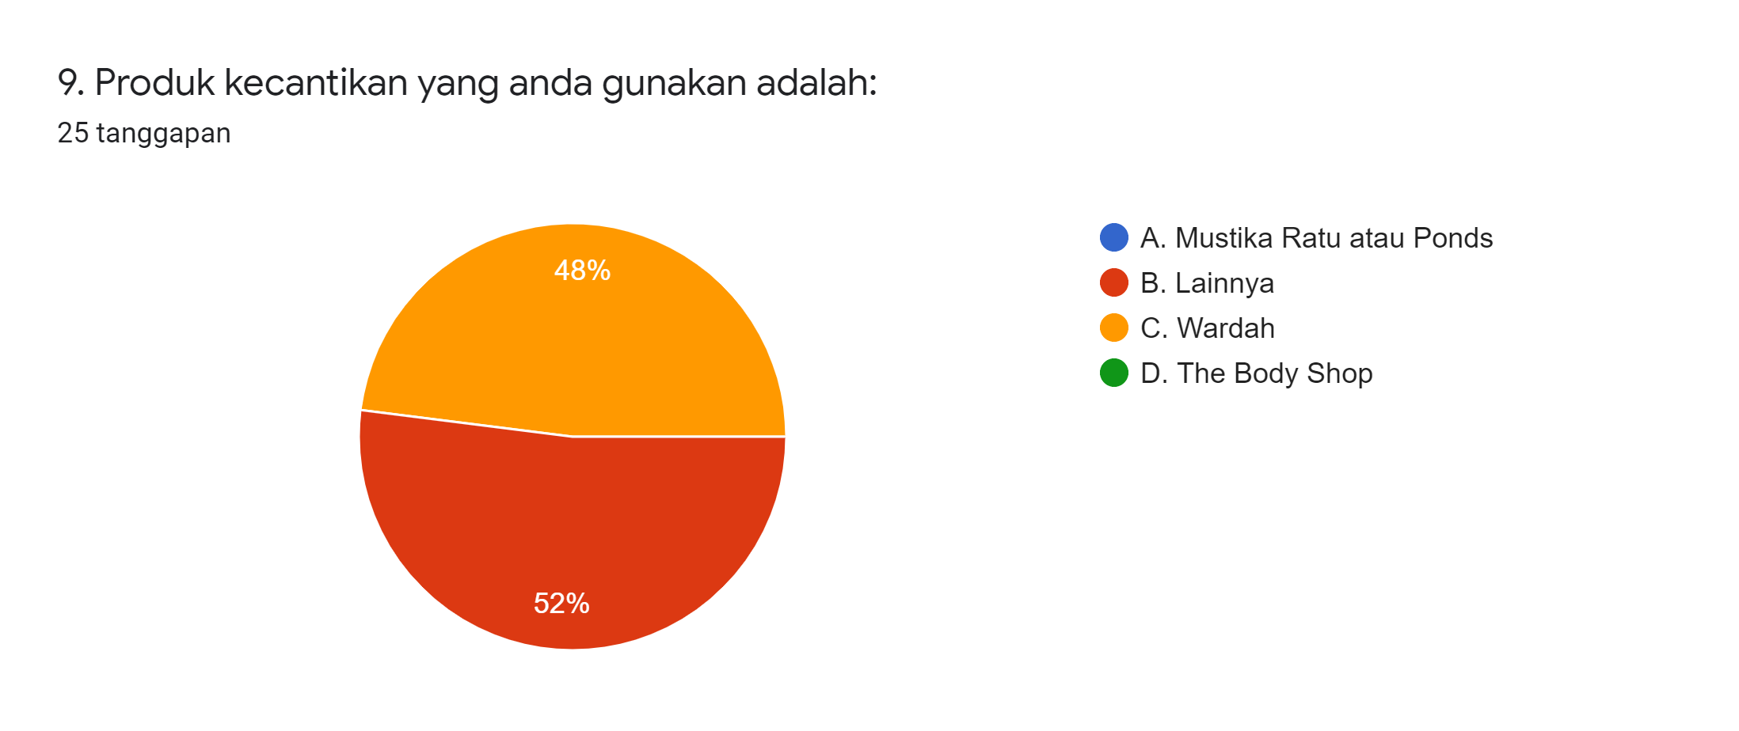
Shampoo, cosmetics, and icon of hijab

Slide 10
Advertisement
In the Morning, afternoon, and night
Movie televion series
Malaysia
Child
movie
Indonesia
comedy
movie
India
Movie
Average: 3 – 6 women wearing hijab,
5 – 10 minute
Result

Slide 11
Halal product
Ingredient
Halal
Perspective
Thoyyib
Process
Marketing
Life style

Slide 12
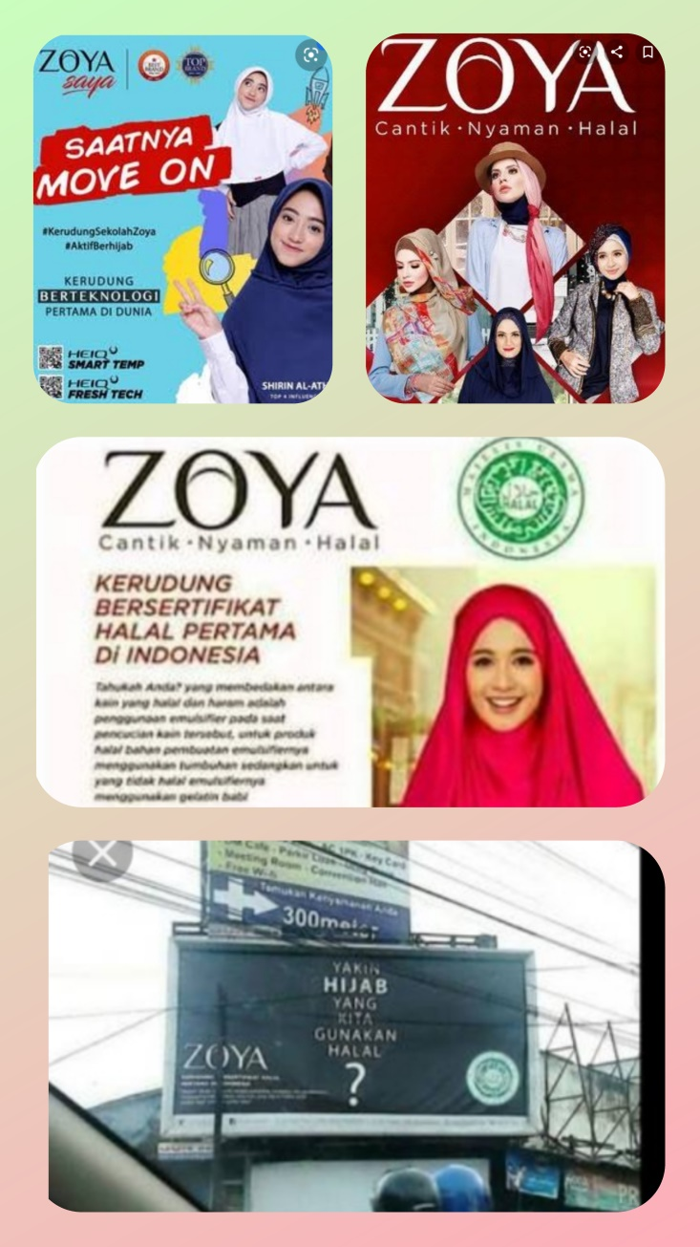

Slide 13
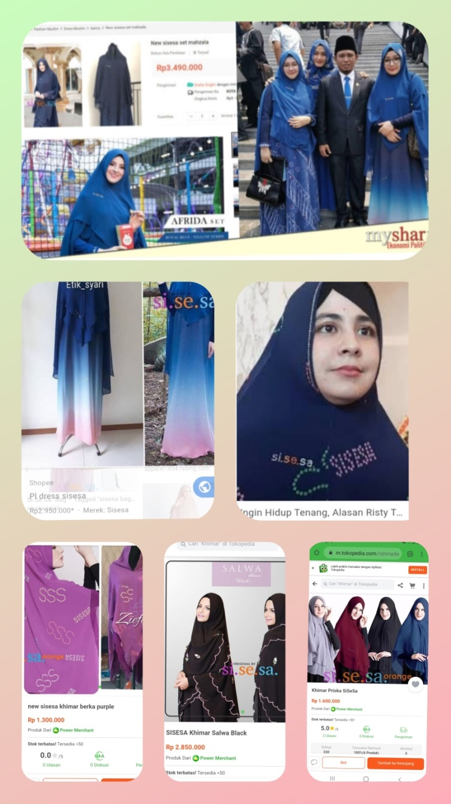

Slide 14
Conclusion
Hijab not only for implementing of syariah but also part of muslim identity
Every single person (muslim) needs halal label
Advertisement: catching opportunity, selling product, and getting the profit
Indonesia; the most muslim population in the world
Regulation halal product
Respect to others
Text in here

Slide 15
Thank You!
ymuthmainnah@gmail.com

